Slide 1
DISCRETE MATHEMATICS CSE 105

Slide 2
Discrete mathematics is the part of mathematics devoted to the study of discrete objects. (Here discrete means consisting of distinct or unconnected elements.)
The kinds of problems solved using discrete mathematics include:
What is the probability of winning a lottery?
Is there a link between two computers in a network?
How can I encrypt a message so that no unintended recipient can read it?
What is the shortest path between two cities using a transportation system?
How can a list of integers be sorted so that the integers are in increasing order?
How many steps are required to do such a sorting?
How can a circuit that adds two integers be designed?
How many valid Internet addresses are there?
WHY STUDY DISCRETE MATHEMATICS?
There are several important reasons for studying discrete mathematics.
First, through this course you can develop your mathematical maturity: that is, your ability to understand and create mathematical arguments.
Second, discrete mathematics provides the mathematical foundations for many computer science courses including data structures, algorithms, database theory, automata theory, formal languages, compiler theory, computer security, and operating systems. Students find these courses much more difficult when they have not had the appropriate mathematical foundations from discrete math.
It is not possible to arrange each of the topic as a separate course organized by mathematics department

Slide 3
Sets
Sets are used to group objects together. Often, but not always, the objects in a set have similar properties.
For instance, all the students who are currently enrolled in your school make up a set. Likewise, all the students currently taking a course in discrete mathematics at any school make up a set.
In addition, those students enrolled in your school who are taking a course in discrete mathematics form a set that can be obtained by taking the elements common to the first two collections.

Slide 4
DEFINITION 1
A set is an unordered collection of objects, called elements or members of the set. A set is said to contain its elements. We write a ∈ A to denote that a is an element of the set A. The Notation ∈ denotes that a is not an element of the set A.
The set V of all vowels in the English alphabet can be written as
V = {a, e, i, o, u}.
Some notations
N = {0, 1, 2, 3, . . .}, the set of natural numbers
Z = {. . . ,−2,−1, 0, 1, 2, . . .}, the set of integers
Z+ = {1, 2, 3, . . .}, the set of positive integers
Q = {p/q | p ∈ Z, q ∈ Z, and q ≠0}, the set of rational numbers
R, the set of real numbers
R+, the set of positive real numbers
C, the set of complex numbers.
O = {x | x is an odd positive integer less than 10},
or,
O = {x ∈ Z+ | x is odd and x < 10}.

Slide 5
List the elements of each set where N = {1, 2, 3, …}.
(a) A = {x ∈ N| 3 < x < 9}
(b) B = {x ∈ N| x is even, x < 11}
(c) C = {x ∈ N| 4 + x = 3}
(a) A consists of the positive integers between 3 and 9; hence A = {4, 5, 6, 7, 8}.
(b) B consists of the even positive integers less than 11; hence B = {2, 4, 6, 8, 10}.
(c) No positive integer satisfies 4 + x = 3; hence C = ∅, the empty set.
Let A = {2, 3, 4, 5}.
(a) Show that A is not a subset of B = {x ∈ N| x is even}.
(b) Show that A is a proper subset of C = {1, 2, 3, . . ., 8, 9}.
(a) It is necessary to show that at least one element in A does not belong to B. Now 3 ∈ A and, since B consists of even numbers, 3 B; hence A is not a subset of B.
(b) Each element of A belongs to C so A ⊆ C. On the other hand, 1 ∈ C but 1 A. Hence A ≠ C. Therefore A is a proper subset of C.

Slide 6
DEFINITION 2
Two sets are equal if and only if they have the same elements. Therefore, if A and B are sets, then A and B are equal if and only if ∀x(x ∈ A ↔ x ∈ B).We write A = B if A and B are equal sets.
The set A is a subset of B if and only if every element of A is also an element of B. We use the notation A ⊆ B to indicate that A is a subset of the set B.
We see that A ⊆ B if and only if the quantification
∀x(x ∈ A → x ∈ B) is true.
Given a set S, the power set of S is the set of all subsets of the set S. The power set of S is denoted by P(S).
Q1. What is the power set of the set {0, 1, 2}?
Solution: The power set P({0, 1, 2}) is the set of all subsets of {0, 1, 2}. Hence,
P({0, 1, 2}) = {∅, {0}, {1}, {2}, {0, 1}, {0, 2}, {1, 2}, {0, 1, 2}}.
Q.2 What is the power set of the empty set? What is the power set of the set {∅}?
Solution: The empty set has exactly one subset, namely, itself. Consequently,
P(∅) = {∅}.
The set {∅} has exactly two subsets, namely, ∅ and the set {∅} itself. Therefore,
P({∅}) = {∅, {∅}}.
DEFINITION 3

Slide 7
Determine the power set P(A) of A = {a, b, c, d}.
The elements of P(A) are the subsets of A. Hence
P(A) = [A, {a, b, c}, {a, b, d}, {a, c, d}, {b, c, d}, {a, b}, {a, c}, {a, d}, {b, c}, {b, d}, {c, d}, {a}, {b}, {c}, {d}, ∅]
Let A and B be sets. The Cartesian product of A and B, denoted by:
A × B, is the set of all ordered pairs (a, b), where a ∈ A and b ∈ B. Hence,
A × B = {(a, b) | a ∈ A ∧ b ∈ B}.
Q3. What is the Cartesian product of A = {1, 2} and B = {a, b, c}?
Solution: The Cartesian product A × B is
A × B = {(1, a), (1, b), (1, c), (2, a), (2, b), (2, c)}.
Q4. Show that the Cartesian product B × A is not equal to the Cartesian product A × B.
Solution: The Cartesian product B × A is
B × A = {(a, 1), (a, 2), (b, 1), (b, 2), (c, 1), (c, 2)} ≠ A × B .
Q.5 What is the Cartesian product A × B × C, where A = {0, 1}, B = {1, 2}, and C = {0, 1, 2} ?
Solution: The Cartesian product A × B × C consists of all ordered triples (a, b, c), where a ∈ A,
b ∈ B, and c ∈ C. Hence,
A × B × C = {(0, 1, 0), (0, 1, 1), (0, 1, 2), (0, 2, 0), (0, 2, 1), (0, 2, 2),
(1, 1, 0), (1, 1, 1), (1, 1, 2), (1, 2, 0), (1, 2, 1), (1, 2, 2)}.
If A = Ø and B = {2, 4}. Find A × B and B × A
Ans. A × B = B × A = Ø

Slide 8
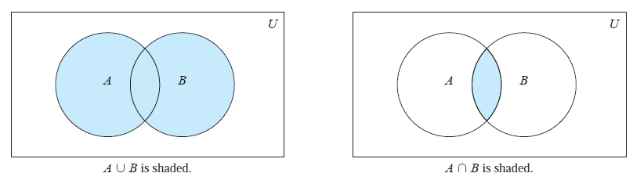
Let A and B be sets. The union of the sets A and B, denoted by A ∪ B, is the set that contains those elements that are either in A or in B, or in both.
The union of the sets {1, 3, 5} and {1, 2, 3} is the set {1, 2, 3, 5}; that is,
{1, 3, 5} ∪ {1, 2, 3} = {1, 2, 3, 5}.
Let A and B be sets. The intersection of the sets A and B, denoted by A ∩ B, is the set containing those elements in both A and B.
The intersection of the sets {1, 3, 5} and {1, 2, 3} is the set {1, 3}; that is,
{1, 3, 5} ∩ {1, 2, 3} = {1, 3}.

Slide 9
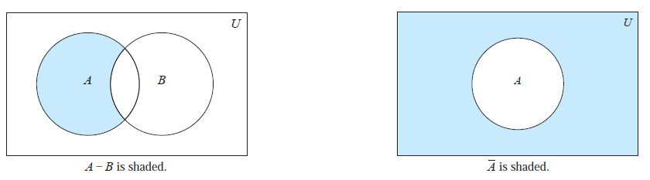
Let A = {1, 3, 5, 7, 9} and B = {2, 4, 6, 8, 10}. Because A ∩ B = ∅, A and B are disjoint.
Let A and B be sets. The difference of A and B, denoted by A − B, is the set containing those elements that are in A but not in B. The difference of A and B is also called the complement of B with respect to A.
Let U be the universal set. The complement of the set A, denoted by A^{c}, is the complement of A with respect to U. Therefore, the complement of the set A is U − A.

Slide 10
Let A = {a, e, i, o, u} (where the universal set is the set of letters of the English alphabet). Then
A^{c} = {b, c, d, f, g, h, j, k, l,m, n, p, q, r, s, t, v, w, x, y, z}.
Let A be the set of positive integers greater than 10 (with universal set the set of all positive integers).
Then
A^{c} = {1, 2, 3, 4, 5, 6, 7, 8, 9, 10}.
Let U = {1,2, …, 9} be the universal set, and let
A = {1, 2, 3, 4, 5}, C= {5, 6, 7, 8, 9}, E= {2, 4, 6, 8},
B = {4, 5, 6, 7}, D= {1, 3, 5, 7, 9}, F = {1, 5, 9}.
Find: (a) A ∪ B and A ∩ B; (b) A ∪ C and A ∩ C; (c) D ∪ F and D ∩ F.
Recall that the union X∪Y consists of those elements in either X or Y (or both), and that the intersection X∩Y consists of those elements in both X and Y .
(a) A ∪ B = {1, 2, 3, 4, 5, 6, 7} and A ∩ B = {4, 5}
(b) A ∪ C = {1, 2, 3, 4, 5, 6, 7, 8, 9} = U and A ∩ C = {5}
(c) D ∪ F = {1, 3, 5, 7, 9} = D and D ∩ F = (1, 5, 9) = F

Slide 11
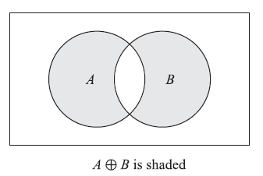
The symmetric difference of sets A and B, denoted by A ⊕ B, consists of those elements which belong to A or B but not to both. That is,
A ⊕ B = (A ∪ B)\(A ∩ B) or A ⊕ B = (A\B) ∪ (B\A)
Figure below is a Venn diagram in which A ⊕ B is shaded.

Slide 12
Suppose U = N = {1, 2, 3, . . .} is the universal set.
Let
A = {1, 2, 3, 4}, B = {3, 4, 5, 6, 7}, C = {2, 3, 8, 9}, E = {2, 4, 6, . . .}
(Here E is the set of even integers.) Then:
A^{C} = {5, 6, 7, . . .}, B^{C} = {1, 2, 8, 9, 10, . . .}, E^{C} = {1, 3, 5, 7, . . .}
That is, E^{C} is the set of odd positive integers. Also:
A\B = {1, 2}, A\C = {1, 4}, B\C = {4, 5, 6, 7}, A\E = {1, 3},
B\A = {5, 6, 7}, C\A = {8, 9}, C\B = {2, 8, 9}, E\A = {6, 8, 10, 12, . . .}.
Furthermore:
A ⊕ B = (A\B) ∪ (B\A) = {1, 2, 5, 6, 7}, B⊕ C = {2, 4, 5, 6, 7, 8, 9},
A ⊕ C = (A\C) ∪ (B\C) = {1, 4, 8, 9}, A⊕ E = {1, 3, 6, 8, 10, . . .}.

Slide 13
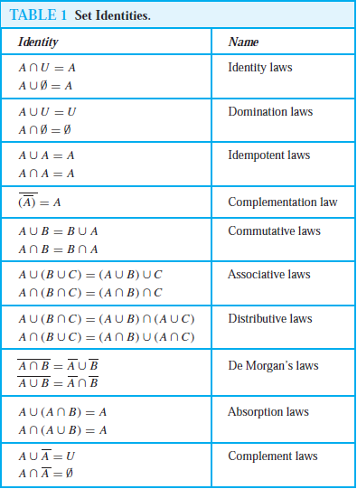
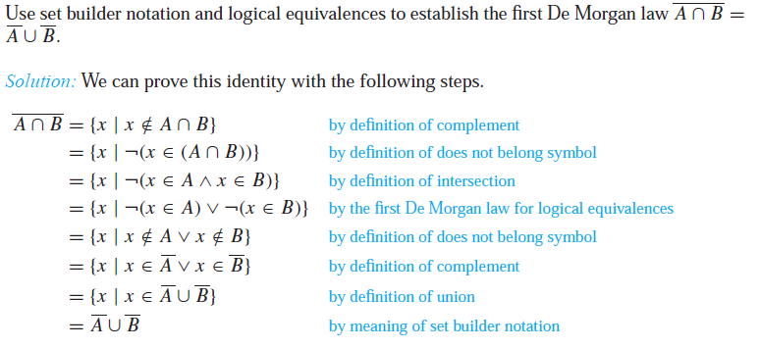

Slide 14
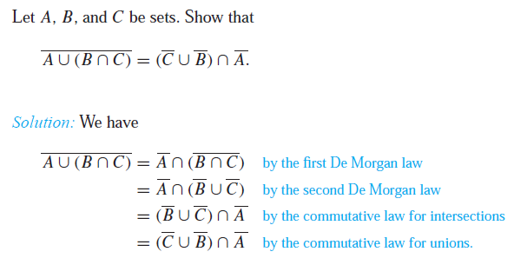
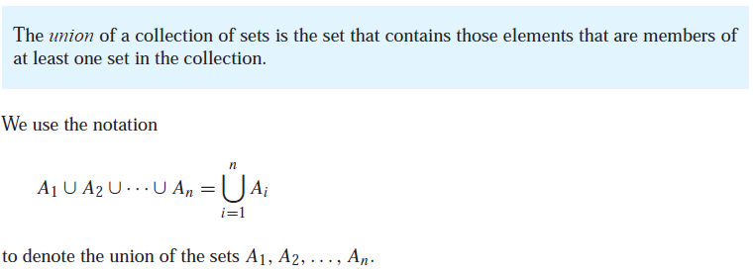
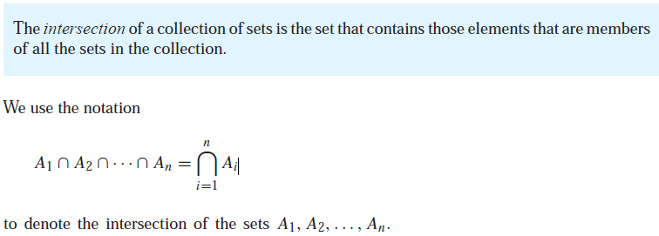

Slide 15
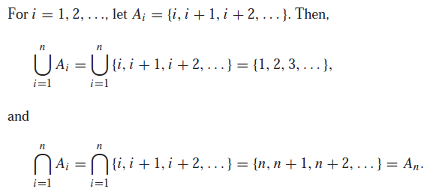
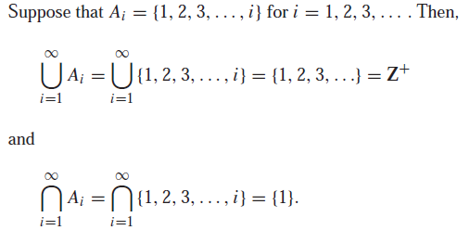
Example
Example

Slide 16
Example
Given, A₁={1, 5}, A₂ = {1,2,4,6}, A₃ = {3, 4,7}, B = {2,4} and
I = {1, 2,3}. Determine the following sets.

Slide 17
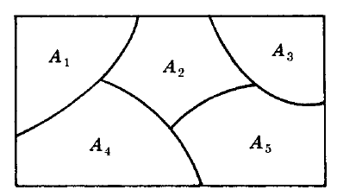
Partitions
Let S be a nonempty set. A partition of S is a subdivision of S into nonoverlapping, nonempty subsets.
Precisely, a partition of S is a collection {A_{i} } of nonempty subsets of S such that:
(i) Each subset in S belongs to one of the A_{i} .
(ii) The sets of {A_{i}} are mutually disjoint; that is, if A_{j} ≠ A_{k} then A_{j} ∩ A_{k} = ∅
The subsets in a partition are called cells. Figure shown below is a Venn diagram of a partition of the rectangular set S of points into five cells, A₁, A₂,A₃,A₄,A₅.

Slide 18
EXAMPLE
Consider the following collections of subsets of S = {1, 2, . . ., 8, 9}:
(i) [{1, 3, 5}, {2, 6}, {4, 8, 9}]
(ii) [{1, 3, 5}, {2, 4, 6, 8}, {5, 7, 9}]
(iii) [{1, 3, 5}, {2, 4, 6, 8}, {7, 9}]
Then (i) is not a partition of S since 7 in S does not belong to any of the subsets. Furthermore, (ii) is not a partition of S since {1, 3, 5} and {5, 7, 9} are not disjoint. On the other hand, (iii) is a partition of S.
Example
Let S = {a, b, c, d, e, f , g}. Determine which of the following are partitions of S:
(a) P₁ = [{a, c, e}, {b}, {d, g}], (c) P₃ = [{a, b, e, g}, {c}, {d, f }],
(b) P₂ = [{a, e, g}, {c, d}, {b, e, f }], (d) P₄ = [{a, b, c, d, e, f , g}].
Ans.
(a) P₁ is not a partition of S since f ∈ S does not belong to any of the cells.
(b) P₂ is not a partition of S since e ∈ S belongs to two of the cells.
(c) P₃ is a partition of S since each element in S belongs to exactly one cell.
(d) P₄ is a partition of S into one cell, S itself.

Slide 19
Example
Find all partitions of S = {a, b, c, d}.
Note first that each partition of S contains either 1, 2, 3, or 4 distinct cells. The partitions are as follows:
(1) [{a, b, c, d}]
(2) [{a}, {b, c, d}], [{b}, {a, c, d}], [{c}, {a, b, d}], [{d}, {a, b, c}],
[{a, b}, {c, d}], [{a, c}, {b, d}], [{a, d}, {b, c}]
(3) [{a}, {b}, {c, d}], [{a}, {c}, {b, d}], [{a}, {d}, {b, c}],
[{b}, {c}, {a, d}], [{b}, {d}, {a, c}], [{c}, {d}, {a, b}]
(4) [{a}, {b}, {c}, {d}]
There are 15 different partitions of S.

Slide 20
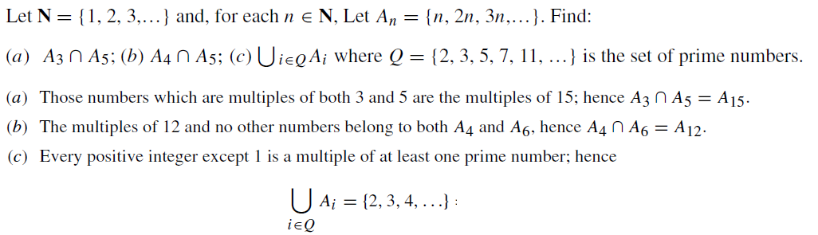
Counting Elements in Finite Sets
The notation n(S) or |S| will denote the number of elements in a set S. (Some texts use #(S) or card(S) instead of n(S).) Thus n(A) = 26, where A is the letters in the English alphabet, and n(D) = 7, where D is the days of the week. Also n(∅) = 0 since the empty set has no elements.
The following lemma applies.
Lemma 1: Suppose A and B are finite disjoint sets. Then A ∪ B is finite and
n(A ∪ B) = n(A) + n(B)

Slide 21
Corollary 1: Let A and B be finite sets. Then
n(A\B) = n(A) − n(A ∩ B)
For example, suppose an art class A has 25 students and 10 of them are taking a biology class B. Then the number of students in class A which are not in class B is:
n(A\B) = n(A) − n(A ∩ B) = 25 − 10 = 15
Corollary 2: Let A be a subset of a finite universal set U. Then
n(A^{C}) = n(U) − n(A)
For example, suppose a class U with 30 students has 18 full-time students. Then there are 30−18 = 12 part-time students in the class U.
Inclusion–Exclusion Principle
There is a formula for n(A ∪ B) even when they are not disjoint, called the Inclusion–Exclusion Principle.
Suppose A and B are finite sets. Then A ∪ B and A ∩ B are finite and
n(A ∪ B) = n(A) + n(B) − n(A ∩ B)
That is, we find the number of elements in A or B (or both) by first adding n(A) and n(B) (inclusion) and then subtracting n(A ∩ B) (exclusion) since its elements were counted twice.
We can apply this result to obtain a similar formula for three sets:
n(A ∪ B ∪ C) = n(A) + n(B) + n(C) − n(A ∩ B) − n(A ∩ C) − n(B ∩ C) + n(A ∩ B ∩ C)

Slide 22
EXAMPLE Suppose a list A contains the 30 students in a mathematics class, and a list B contains the 35 students in an English class, and suppose there are 20 names on both lists. Find the number of students:
only on list A, (b) only on list B, (c) on list A or B (or both), (d) on exactly one list.
(a) List A has 30 names and 20 are on list B; hence 30 − 20 = 10 names are only on list A.
(b) Similarly, 35 − 20 = 15 are only on list B.
(c) We seek n(A ∪ B). By inclusion–exclusion,
n(A ∪ B) = n(A) + n(B) − n(A ∩ B) = 30 + 35 − 20 = 45.
In other words, we combine the two lists and then cross out the 20 names which appear twice.
(d) By (a) and (b), 10 + 15 = 25 names are only on one list; that is, n(A ⊕ B) = 25.

Slide 23
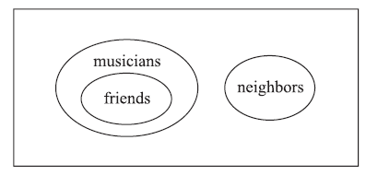
Example
Determine the validity of the following argument:
S₁: All my friends are musicians.
S₂: John is my friend.
S₃: None of my neighbours are musicians.
____________________________
S : John is not my neighbour.
The premises S₁ and S₃ lead to the Venn diagram in Fig. below. By S₂, John belongs to the set of friends which is disjoint from the set of neighbors. Thus S is a valid conclusion and so the argument is valid.

Slide 24
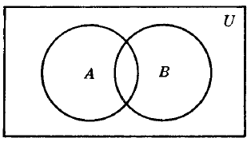
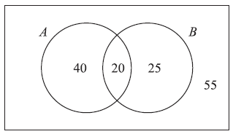
Example
Each student in Philosophy at Jahangirngar University requires to complete Science indicated as: A and Mathematics as B.
A poll of 140 students shows that:
60 completed A, 45 completed B, 20 completed both A and B.
Use a Venn diagram to find the number of students who have completed:
(a) At least one of A and B; (b) exactly one of A or B; (c) neither A nor B.
Ans.
Let us translating the above data into set notation yields:
n(A) = 60, n(B) = 45, n(A ∩ B) = 20, n(U) = 140
Corresponding Venn diagram of sets A and B is shown below.
Now we get,
20 completed both A and B, so n(A ∩ B) = 20.
60 − 20 = 40 completed A but not B, s on(A\B) = 40.
45 − 20 = 25 completed B but not A, so n(B\A) = 25.
140 − 20 − 40 − 25 = 55 completed neither A nor B.
By the Venn diagram:
(a) 20+ 40 + 25 = 85 completed A or B. Alternately, by the Inclusion–Exclusion Principle:
n(A ∪ B) = n(A) + n(B) − n(A ∩ B) = 60 + 45 − 20 = 85
(b) 40+ 25 = 65 completed exactly one requirement. That is, n(A ⊕ B) = 65.
(c) 55 completed neither requirement, i.e. n(AC ∩ BC) = n[(A ∪ B)C] = 140 − 85 = 55.

Slide 25
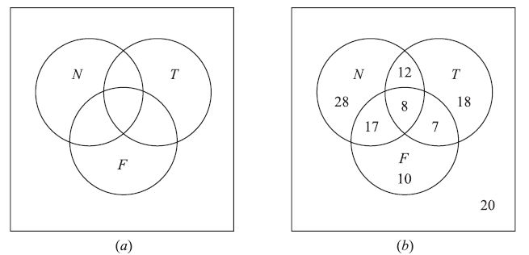
Example
In a survey of 120 people, it was found that:
65 read Newsweek magazine, 20 read both Newsweek and Time,
45 read Time, 25 read both Newsweek and Fortune,
42 read Fortune, 15 read both Time and Fortune,
8 read all three magazines.
(a) Find the number of people who read at least one of the three magazines.
(b) Fill in the correct number of people in each of the eight regions of the Venn diagram in Fig. a where N, T , and F denote the set of people who read Newsweek, Time, and Fortune, respectively.
(c) Find the number of people who read exactly one magazine.

Slide 26
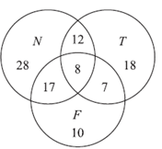
(a) We want to find n(N ∪ T ∪ F).
n(N ∪ T ∪ F)= n(N) + n(T ) + n(F ) − n(N ∩ T ) − n(N ∩ F) − n(T ∩ F) + n(N ∩ T ∩ F)
= 65 + 45 + 42 − 20 − 25 − 15 + 8 = 100
(b) The required Venn diagram in Fig. b is obtained as follows:
8 read all three magazines,
20 − 8 = 12 read Newsweek and Time but not all three magazines,
25 − 8 = 17 read Newsweek and Fortune but not all three magazines,
15 − 8 = 7 read Time and Fortune but not all three magazines,
65 − 12 − 8 − 17 = 28 read only Newsweek,
45 − 12 − 8 − 7 = 18 read only Time,
42 − 17 − 8 − 7 = 10 read only Fortune,
120 − 100 = 20 read no magazine at all.
(c) 28+ 18 + 10 = 56 read exactly one of the magazines.

Slide 27
Propositions
A proposition is a declarative sentence (that is, a sentence that declares a fact) that is either true or false, but not both.
EXAMPLE 1 All the following declarative sentences are propositions.
1. Washington, D.C., is the capital of the United States of America.
2. Toronto is the capital of Canada.
3. 1 + 1 = 2.
4. 2 + 2 = 3.
Propositions 1 and 3 are true, whereas 2 and 4 are false.

Slide 28
Some sentences that are not propositions are given in Example 2.
EXAMPLE 2 Consider the following sentences.
1. What time is it?
2. Read this carefully.
3. x + 1 = 2.
4. x + y = z.
Sentences 1 and 2 are not propositions because they are not declarative sentences. Sentences 3 and 4 are not propositions because they are neither true nor false. Note that each of sentences 3
and 4 can be turned into a proposition if we assign values to the variables.
We use letters to denote propositional variables. The truth value of a proposition is true, denoted by T, if it is a true proposition, and the truth value of a proposition is false, denoted by F, if it is a false proposition. The area of logic that deals with propositions is called the propositional calculus or propositional logic.
DEFINITION 1 Let p be a proposition. The negation of p, denoted by ￢p (also denoted by p), is the statement
“It is not the case that p.”
The proposition ￢p is read “not p.” The truth value of the negation of p, ￢p, is the opposite of the truth value of p.

Slide 29
EXAMPLE 3 Find the negation of the proposition
“Michael’s PC runs Linux”
and express this in simple English.
Solution: The negation is
“It is not the case that Michael’s PC runs Linux.”
This negation can be more simply expressed as
“Michael’s PC does not run Linux.”
Table 1 displays the truth table for the negation of a proposition p.

Slide 30
DEFINITION 2 Let p and q be propositions. The conjunction of p and q, denoted by p ∧ q, is the proposition “p and q.” The conjunction p ∧ q is true when both p and q are true and is false otherwise.
EXAMPLE 4 Find the conjunction of the propositions p and q where p is the proposition “Rebecca’s PC has more than 16 GB free hard disk space” and q is the proposition “The processor in Rebecca’s PC runs faster than 1 GHz.”
Solution: The conjunction of these propositions, p∧q, is the proposition “Rebecca’s PC has more than 16 GB free hard disk space, and the processor in Rebecca’s PC runs faster than 1 GHz.” This conjunction can be expressed more simply as “Rebecca’s PC has more than 16 GB free hard disk space, and its processor runs faster than 1 GHz.”

Slide 31
DEFINITION 3 Let p and q be propositions. The disjunction of p and q, denoted by p ∨ q, is the proposition “p or q.” The disjunction p ∨ q is false when both p and q are false and is true otherwise.
EXAMPLE 5 What is the disjunction of the propositions p and q where p and q are the same propositions as in Example 5?
Solution: The disjunction of p and q, p ∨ q, is the proposition
“Rebecca’s PC has at least 16 GB free hard disk space, or the processor in Rebecca’s PC runs faster than 1 GHz.”

Slide 32
DEFINITION 4 Let p and q be propositions. The exclusive or of p and q, denoted by p ⊕ q, is the proposition that is true when exactly one of p and q is true and is false otherwise.
DEFINITION 5 Let p and q be propositions. The conditional statement p → q is the proposition “if p, then q.” The conditional statement p → q is false when p is true and q is false, and true otherwise. In the conditional statement p → q, p is called the hypothesis (or antecedent or premise) and q is called the conclusion (or consequence).

Slide 33
DEFINITION 6 Let p and q be propositions. The biconditional statement p ↔ q is the proposition “p if and only if q.” The biconditional statement p ↔ q is true when p and q have the same truth values, and is false otherwise. Biconditional statements are also called bi-implications.
EXAMPLE 6 Construct the truth table of the compound proposition (p ∨￢q) → (p ∧ q).

Slide 34
Translating English Sentences
There are many reasons to translate English sentences into expressions involving propositional variables and logical connectives. In particular, English (and every other human language) is often ambiguous. Translating sentences into compound statements (and other types of logical expressions, which we will introduce later in this chapter) removes the ambiguity.
EXAMPLE 7 How can this English sentence be translated into a logical expression?
“You can access the Internet from campus only if you are a computer science major or you are not a freshman.”
Solution: Let a, c, and f represent “You can access the Internet from campus,” “You are a computer science major,” and “You are a freshman,” respectively. Noting that “only if” is one way a conditional statement can be expressed, this sentence can be represented as
a → (c ∨￢f ).
EXAMPLE 8 How can this English sentence be translated into a logical expression?
“You cannot ride the roller coaster if you are under 4 feet tall unless you are older than 16 years old.”
Solution: Let q, r, and s represent “You can ride the roller coaster,” “You are under 4 feet tall,” and “You are older than 16 years old,” respectively. Then the sentence can be translated to
(r ∧￢s)→￢q.
Of course, there are other ways to represent the original sentence as a logical expression, but the one we have used should meet our needs.

Slide 35
Propositional Equivalences
DEFINITION 1 A compound proposition that is always true, no matter what the truth values of the propositional variables that occur in it, is called a tautology. A compound proposition that is always false is called a contradiction. A compound proposition that is neither a tautology nor a contradiction is called a contingency.
EXAMPLE 9 We can construct examples of tautologies and contradictions using just one propositional variable. Consider the truth tables of p ∨￢p and p ∧￢p, shown in Table 1. Because p ∨￢p is always true, it is a tautology. Because p ∧￢p is always false, it is a contradiction.
Logical Equivalences
Compound propositions that have the same truth values in all possible cases are called logically equivalent. We can also define this notion as follows.
DEFINITION 2 The compound propositions p and q are called logically equivalent if p ↔ q is a tautology. The notation p ≡ q denotes that p and q are logically equivalent.

Slide 36
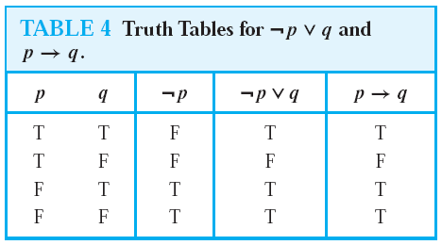
EXAMPLE 10 Show that ￢(p ∨ q) and ￢p ∧￢q are logically equivalent.
Solution: The truth tables for these compound propositions are displayed in Table 3. Because the truth values of the compound propositions ￢(p ∨ q) and ￢p ∧￢q agree for all possible combinations of the truth values ofp and q, it follows that ￢(p ∨ q) ↔ (￢p ∧￢q) is a tautology and that these compound propositions are logically equivalent.
Show that p → q and ￢p ∨ q are logically equivalent.
Solution:We construct the truth table for these compound propositions in Table 4. Because the truth values of ￢p ∨ q and p → q agree, they are logically equivalent.

Slide 37
EXAMPLE 11 Show that p ∨ (q ∧ r) and (p ∨ q) ∧ (p ∨ r) are logically equivalent. This is the distributive law of disjunction over conjunction.

Slide 38
Table 6 contains some important equivalences. In these equivalences, T denotes the compound proposition that is always true and F denotes the compound proposition that is always false.

Slide 39
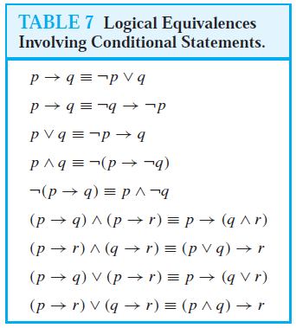
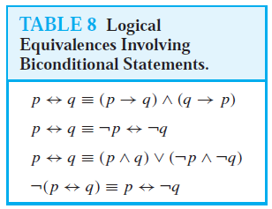
De Morgan’s laws:
￢(p₁ ∨ p₂ ∨ ・ ・ ・ ∨ p_{n}) ≡ (￢p₁ ∧￢p₂ ∧ ・・・ ∧ ￢p_{n})
And
￢(p1 ∧ p2 ∧ ・ ・ ・ ∧ pn) ≡ (￢p1 ∨￢p2 ∨ ・・・ ∨ ￢pn).

Slide 40
EXAMPLE 12 Show that ￢(p ∨ (￢p ∧ q)) and ￢p ∧￢q are logically equivalent by developing a series of logical equivalences.
Ans.
￢(p ∨ (￢p ∧ q)) ≡ ￢p ∧￢(￢p ∧ q) by De Morgan law
≡ ￢p ∧ [￢(￢p)∨￢q] by De Morgan law
≡ ￢p ∧ (p ∨￢q) by the double negation law
≡ (￢p ∧ p) ∨ (￢p ∧￢q) by the distributive law
≡ F ∨ (￢p ∧￢q) because ￢p ∧ p ≡ F
≡ (￢p ∧￢q) ∨F by the commutative law for disjunction
≡ ￢p ∧￢q by the identity law for F

Slide 41
EXAMPLE 13 Show that (p ∧ q) → (p ∨ q) is a tautology.
Solution: To show that this statement is a tautology, we will use logical equivalences to demonstrate that it is logically equivalent to T. (Note: This could also be done using a truth table.)
(p ∧ q) → (p ∨ q) ≡ ￢(p ∧ q) ∨ (p ∨ q) by Example 3
≡ (￢p ∨￢q) ∨ (p ∨ q) by De Morgan law
≡ (￢p ∨ p) ∨ (￢q ∨ q)
by the associative and commutative laws for disjunction
≡ T ∨ T
≡ T
Example-14
Let p be “It is cold” and let q be “It is raining”. Give a simple verbal sentence which describes each of the
following statements: (a) ￢p; (b) p ∧ q; (c) p ∨ q; (d) q ∨￢p.
In each case, translate ∧, ∨, and ∼ to read “and,” “or,” and “It is false that” or “not,” respectively, and then simplify
the English sentence.
(a) It is not cold. (c) It is cold or it is raining.
(b) It is cold and raining. (d) It is raining or it is not cold.

Slide 42
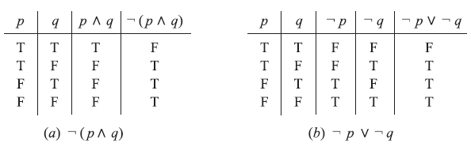
Example-15
Use the laws show that ￢(p ∧ q) ∨ (￢p ∧ q) ≡ ￢p.
Statement Reason
(1) ￢(p ∨ q) ∨ (￢p ∧ q) ≡ (￢p ∧￢q) ∨ (￢p ∧ q) DeMorgan’s law
(2) ≡ ￢p ∧ (￢q ∨ q) Distributive law
(3) ≡ ￢p ∧ T Complement law
(4) ≡ ￢p Identity law
Example-16
Show that the propositions ￢(p ∧ q) and ￢p ∨￢q are logically equivalent.

Slide 43
Rules of Inference
ARGUMENTS
DEFINITION 1 An argument in propositional logic is a sequence of propositions. All but the final proposition in the argument are called premises and the final proposition is called the conclusion. An argument is valid if the truth of all its premises implies that the conclusion is true.
An argument is an assertion that a given set of propositions P₁, P₂,… ,P_{n}, called premises, yields (has a consequence) another proposition Q, called the conclusion. Such an argument is denoted by,
P₁, P₂, . . . , P ┤Q
An argument P₁, P₂, . . . , P_{n} ┤ Q is said to be valid if Q is true whenever all the premises P₁, P₂, . . . , P_{n} are true.
An argument which is not valid is called fallacy.

Slide 44
Valid Arguments in Propositional Logic
Consider the following argument involving propositions (which, by definition, is a sequence of propositions):
“If you have a current password, then you can log onto the network.”
“You have a current password.”
Therefore,
“You can log onto the network.”
We would like to determine whether this is a valid argument. That is, we would like to determine whether the conclusion “You can log onto the network” must be true when the premises “If you have a current password, then you can log onto the network” and “You have a current password” are both true.

Slide 45
Before we discuss the validity of this particular argument, we will look at its form. Use p to represent “You have a current password” and q to represent “You can log onto the network.” Then, the argument has the form
p → q
P
∴ q
where ∴ is the symbol that denotes “therefore.”
The argument we obtain by substituting these values of p and q into the argument form is
“If you have access to the network, then you can change your grade.”
“You have access to the network.”
_______________________________________________________
∴ “You can change your grade.”

Slide 46
We know that when p and q are propositional variables, the statement ((p → q) ∧ p) → q is a tautology (shown in previous lecture). In particular, when both p → q and p are true, we know that q must also be true. We say this form of argument is valid because whenever all its premises (all statements in the argument other than the final one, the conclusion) are true, the conclusion must also be true.
Rules of Inference for Propositional Logic
We can always use a truth table to show that an argument form is valid. We do this by showing that whenever the premises are true, the conclusion must also be true.
However, this can be a tedious approach. For example, when an argument form involves 10 different propositional variables, to use a truth table to show this argument form is valid requires 2¹⁰ = 1024 different rows.
Fortunately, we do not have to resort to truth tables. Instead, we can first establish the validity of some relatively simple argument forms, called rules of inference.
46

Slide 47
The tautology (p ∧ (p → q)) → q is the basis of the rule of inference called modus ponens. (Modus ponens is Latin for mode that affirms.) This tautology leads to the following valid argument form, which we have already seen in our initial discussion about arguments (where, as before, the symbol ∴ denotes “therefore”):
p
p → q
∴ q
47

Slide 48
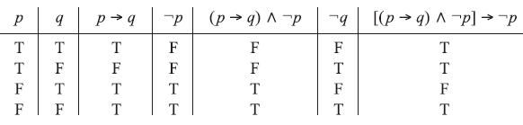
Example-1
Show that the following argument is a fallacy: p → q, ￢p ┤ ￢q.
Ans.
Construct the truth table for [(p → q)∧￢p] → ￢q as in Fig. below. Since the proposition [(p → q)∧￢p] → ￢q
is not a tautology, the argument is a fallacy. Equivalently, the argument is a fallacy since in the third line of the truth
table p → q and ￢p are true but ￢q is false.

Slide 49
Example-2
Prove the following argument is valid: p →￢q, r → q, r ┤ ￢p.
Construct the truth table of the premises and conclusions as in Fig. below. Now, p → ￢q, r → q, and r are true simultaneously only in the fifth row of the table, where ￢p is also true. Hence the argument is valid
EXAMPLE 3 Consider the following argument:
S₁ : If a man is a bachelor, he is unhappy.
S₂ : If a man is unhappy, he dies young.
___________________________________________________________________
S : Bachelors die young
Here the statement S below the line denotes the conclusion of the argument, and the statements S₁ and S₂ above the line denote the premises. We claim that the argument S₁, S₂ ┤ S is valid. For the argument is of the form
p → q, q → r ┤ p → r
where p is “He is a bachelor,” q is “He is unhappy” and r is “He dies young;” this argument (Law of Syllogism) is valid.

Slide 50
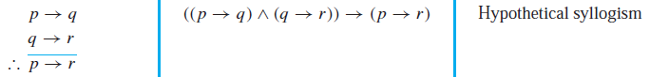
EXAMPLE 4
Determine the validity of the following argument:
If 7 is less than 4, then 7 is not a prime number.
7 is not less than 4.
-------------------------------------------------------------
∴ 7 is a prime number.
First translate the argument into symbolic form. Let p be “7 is less than 4” and q be “7 is a prime number.” Then the argument is of the form
p →￢q, ￢q ┤ q
Now, we construct a truth table as shown below. The above argument is shown to be a fallacy since, in the fourth line of the truth table, the premises p →￢q and ￢p are true, but the conclusion q is false.

Slide 51
EXAMPLE 5
Test the validity of the following argument:
If two sides of a triangle are equal, then the opposite angles are equal.
Two sides of a triangle are not equal.
------------------------------------------------------------
∴ The opposite angles are not equal.
First translate the argument into the symbolic form p → q, ￢p ┤ ￢q, where p is “Two sides of a triangle are equal” and q is “The opposite angles are equal.” By previous exampe-1, this argument is a fallacy.
EXAMPLE 6

Slide 52
EXAMPLE 7 State which rule of inference is the basis of the following argument: “It is below freezing now. Therefore, it is either below freezing or raining now.”
Solution: Let p be the proposition “It is below freezing now” and q the proposition “It is raining now.” Then this argument is of the form
p
∴ p ∨ q
This is an argument that uses the addition rule.
Rule
EXAMPLE 8 State which rule of inference is the basis of the following argument: “It is below freezing and raining now. Therefore, it is below freezing now.”
Solution: Let p be the proposition “It is below freezing now,” and let q be the proposition “It is raining now.” This argument is of the form
p ∧ q
∴ p
This argument uses the simplification rule.

Slide 53
EXAMPLE 9 State which rule of inference is used in the argument:
If it rains today, then we will not have a barbecue today. If we do not have a barbecue today, then we will have a barbecue tomorrow. Therefore, if it rains today, then we will have a barbecue tomorrow.
Solution: Let p be the proposition “It is raining today,” let q be the proposition “We will not have a barbecue today,” and let r be the proposition “We will have a barbecue tomorrow.” Then this argument is of the form
p → q
q → r
∴ p → r
Hence, this argument is a hypothetical syllogism.
EXAMPLE 10 Show that the premises “It is not sunny this afternoon and it is colder than yesterday,” “We will go swimming only if it is sunny,” “If we do not go swimming, then we will take a canoe trip,” and “If we take a canoe trip, then we will be home by sunset” lead to the conclusion “We will be home by sunset.”
Solution: Let p be the proposition “It is sunny this afternoon,” q the proposition “It is colder than yesterday,” r the proposition “We will go swimming,” s the proposition “We will take a canoe trip,” and t the proposition “We will be home by sunset.” Then the premises become ￢p ∧ q, r → p, ￢r → s, and s → t . The conclusion is simply t . We need to give a valid argument with premises ￢p ∧ q, r → p, ￢r → s, and s → t and conclusion t . We construct an argument to show that our premises lead to the desired conclusion as
follows.

Slide 54
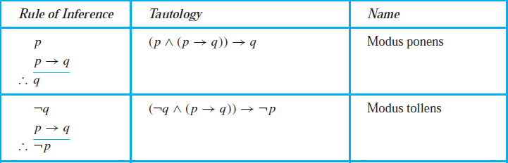
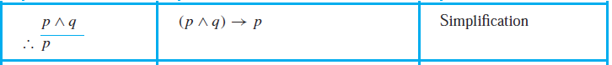
Step Reason
1. ￢p ∧ q Premise
2. ￢p Simplification using (1)
3. r → p Premise
4. ￢r Modus tollens using (2) and (3)
5. ￢r → s Premise
6. s Modus ponens using (4) and (5)
7. s → t Premise
8. t Modus ponens using (6) and (7)
Note that we could have used a truth table to show that whenever each of the four hypotheses is true, the conclusion is also true. However, because we are working with five propositional variables, p, q, r, s, and t , such a truth table would have 32 rows.

Slide 55
EXAMPLE 11 Show that the premises “If you send me an e-mail message, then I will finish writing the program,” “If you do not send me an e-mail message, then I will go to sleep early,” and “If I go to sleep early, then I will wake up feeling refreshed” lead to the conclusion “If I do not finish writing the program, then I will wake up feeling refreshed.”
Solution: Let p be the proposition “You send me an e-mail message,” q the proposition “I will finish writing the program,” r the proposition “I will go to sleep early,” and s the proposition “I Will wake up feeling refreshed.” Then the premises are p → q,￢p → r, and r → s. The desired conclusion is ￢q → s. We need to give a valid argument with premises p → q, ￢p → r, and r → s and conclusion ￢q → s. This argument form shows that the premises lead to the desired conclusion.
Step Reason
1. p → q Premise
2. ￢q →￢p Contrapositive of (1)
3. ￢p → r Premise
4. ￢q → r Hypothetical syllogism using (2) and (3)
5. r → s Premise
6. ￢q → s Hypothetical syllogism using (4) and (5)

Slide 56
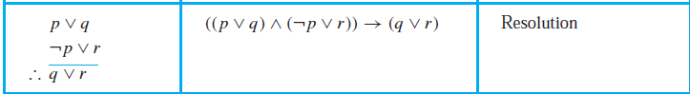
EXAMPLE 12 Use resolution to show that the hypotheses “Jasmine is skiing or it is not snowing” and “It is snowing or Bart is playing hockey” imply that “Jasmine is skiing or Bart is playing hockey.”
Solution: Let p be the proposition “It is snowing,” q the proposition “Jasmine is skiing,” and r the proposition “Bart is playing hockey.”We can represent the hypotheses as ￢p ∨ q and p ∨ r, respectively. Using resolution, the proposition q ∨ r, “Jasmine is skiing or Bart is playing hockey,” follows.
Rules of Inference for Quantified Statements
We have discussed rules of inference for propositions. We will nowdescribe some important rules of inference for statements involving quantifiers. These rules of inference are used extensively
in mathematical arguments, often without being explicitly mentioned.

Slide 57
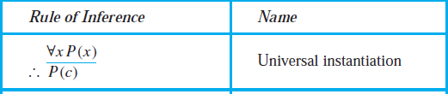
EXAMPLE 13 Show that the premises “Everyone in this discrete mathematics class has taken a course in computer science” and “Marla is a student in this class” imply the conclusion “Marla has taken a course in computer science.”
Solution: Let D(x) denote “x is in this discrete mathematics class,” and let C(x) denote “x has taken a course in computer science.” Then the premises are ∀x(D(x) → C(x)) and D(Marla). The conclusion is C(Marla). The following steps can be used to establish the conclusion from the premises.
Step Reason
1. ∀x(D(x) → C(x)) Premise
2. D(Marla)→C(Marla) Universal instantiation from (1)
3. D(Marla) Premise
4. C(Marla) Modus ponens from (2) and (3)

Slide 58
EXAMPLE 14: Show that the premises “A student in this class has not read the book,” and “Everyone in this class passed the first exam” imply the conclusion “Someone who passed the first exam has not read the book.”
Solution: Let C(x) be “x is in this class,” B(x) be “x has read the book,” and P(x) be “x passed the first exam.” The premises are ∃x(C(x)∧￢B(x)) and ∀x(C(x) → P(x)). The conclusion
is ∃x(P(x)∧￢B(x)). These steps can be used to establish the conclusion from the premises.
Step Reason
1. ∃x(C(x)∧￢B(x)) Premise
2. C(a)∧￢B(a) Existential instantiation from (1)
3. C(a) Simplification from (2)
4. ∀x(C(x) → P(x)) Premise
5. C(a) → P(a) Universal instantiation from (4)
6. P(a) Modus ponens from (3) and (5)
7. ￢B(a) Simplification from (2)
8. P(a)∧￢B(a) Conjunction from (6) and (7)
9. ∃x(P(x)∧￢B(x)) Existential generalization from (8)

Slide 59
Methods of Proving Theorems
Direct Proofs
A direct proof shows that a conditional statement p → q is true by showing that if p is true, then q must also be true, so that the combination p true and q false never occurs.
EXAMPLE 1 Give a direct proof of the theorem “If n is an odd integer, then n² is odd.”
By the definition of an odd integer, it follows that n = 2k + 1, where k is some integer. We want to show that n² is also odd. We can square both sides of the equation n = 2k + 1 to obtain a new equation that expresses n². When we do this, we find that n2 = (2k + 1)² = 4k2 + 4k + 1 = 2(2k² + 2k) + 1. By the definition of an odd integer, we can conclude that n² is an odd integer (it is one more than twice an integer). Consequently, we have proved that if n is an odd integer, then n² is an odd integer.
Proof by contraposition
Proofs by contraposition make use of the fact that the conditional statement p → q is equivalent to its contrapositive, ￢q →￢p. This means that the conditional statement p → q can be proved by
showing that its contrapositive, ￢q →￢p, is true.

Slide 60
EXAMPLE 2 Prove that if n is an integer and 3n + 2 is odd, then n is odd.
Solution: The first step in a proof by contraposition is to assume that the conclusion of the conditional statement “If 3n + 2 is odd, then n is odd” is false; namely, assume that n is even. Then, by the definition of an even integer, n = 2k for some integer k. Substituting 2k for n, we find that 3n + 2 = 3(2k) + 2 = 6k + 2 = 2(3k + 1). This tells us that 3n + 2 is even (because it is a multiple of 2), and therefore not odd. This is the negation of the premise of the theorem. Because the negation of the conclusion of the conditional statement implies that the hypothesis is false, the original conditional statement is true. Our proof by contraposition succeeded; we have proved the theorem “If 3n + 2 is odd, then n is odd.”
Proofs by Contradiction
Suppose we want to prove that a statement p is true. we can conclude that ￢p is false, which means that p is true.
Example-3
Prove that √2 is irrational by giving a proof by contradiction.
Solution: To start a proof by contradiction, we suppose that ￢p is true. Note that ￢p is the statement “It is not the case that √2 is irrational,” which says that √2 is rational. If √2 is rational, there exist integers a and b with √2 = a/b, where b ≠ 0 and a and b have no common factors (so that the fraction a/b is in lowest terms.) (Here, we are using the fact that every rational number can be written in lowest terms.)

Slide 61
Note that the statement that √2 = a/b, where a and b have no common factors, means, in particular, that 2 does not divide both a and b. Because our assumption of ￢p leads to the contradiction that 2 divides both a and b and 2 does not divide both a and b, ￢p must be false. That is, the statement p, “√2 is irrational,” is true. We have proved that √2 is irrational.
EXHAUSTIVEPROOF Some theorems can be proved by examining a relatively small number of examples. Such proofs are called exhaustive proofs, or proofs by exhaustion because these proofs proceed by exhausting all possibilities. An exhaustive proof is a special type of proof by cases where each case involves checking a single example. We now provide some illustrations of exhaustive proofs.
EXAMPLE 1 Prove that (n + 1)³ ≥ 3^{n} if n is a positive integer with n ≤ 4.
Solution: We use a proof by exhaustion. We only need verify the inequality (n + 1)³ ≥ 3^{n} when n = 1, 2, 3, and 4. For n = 1, we have (n + 1)³ = 2³ = 8 and 3^{n} = 3¹ = 3; for n = 2, we have (n + 1)³ = 3³ = 27 and 3^{n} = 3² = 9; for n = 3, we have (n + 1)³ = 4³ = 64 and 3^{n} = 3³ = 27; and for n = 4, we have (n + 1)³ = 5³ = 125 and 3^{n} = 3⁴ = 81. In each of
these four cases, we see that (n + 1)³ ≥ 3^{n}. We have used the method of exhaustion to prove that (n + 1)³ ≥ 3^{n} if n is a positive integer with n ≤ 4.

Slide 62
Relations
PRODUCT SETS
Consider two arbitrary sets A and B. The set of all ordered pairs:
(a, b) where a ∈ A and b ∈ B is called the product, or Cartesian product, of A and B. A short designation of this product is A × B, which is read “A cross B.” By definition,
A × B = {(a, b) | a ∈ A and b ∈ B}
One frequently writes A² instead of A × A.
Example-1
Let A = {1, 2} and B = {a, b, c}. Then
A × B = {(1, a), (1, b), (1, c), (2, a), (2, b), (2, c)}
B × A = {(a, 1), (b, 1), (c, 1), (a, 2), (b, 2), (c, 2)}
Also, A × A = {(1, 1), (1, 2), (2, 1), (2, 2)}

Slide 63
Definition: Let A and B be sets. A binary relation or, simply, relation from A to B is a subset of A × B.
Suppose R is a relation from A to B. Then R is a set of ordered pairs where each first element comes from A and each second element comes from B. That is, for each pair a ∈ A and b ∈ B, exactly one of the following is true:
(i) (a, b) ∈ R; we then say “a is R-related to b”, written aRb.
(ii) (a, b) ∈ R; we then say “a is not R-related to b”, written aRb.
Example-2
Let A be the set of cities in the Bangladesh., and let B be the set of the 8 divisions in the Bangladesh. Define the relation R by specifying that (a, b) belongs to R if a city with name a is in the division b. For instance, (Uttrra, Dhaka), (Jessore, Khulna), (Sirajgonj, Rajshahi), (Feni, Chittagong), (Comilla, Chittagong), (Sunamgonj, Shylet), and (Bhola, Barisal) are in R.
The domain of a relation R is the set of all first elements of the ordered pairs which belong to R, and the range is the set of second elements.
Example-3
A = (1, 2, 3) and B = {x, y, z}, and let R = {(1, y), (1, z), (3, y)}. Then R is a relation from A to B since R is a subset of A × B. With respect to this relation, 1Ry, 1Rz, 3Ry, but 1Rx, 2Rx, 2Ry, 2Rz, 3Rx, 3Rz
The domain of R is {1, 3} and the range is {y, z}

Slide 64
DEFINITION 1 Let A and B be sets. A binary relation from A to B is a subset of A × B.
EXAMPLE 4 Let A be the set {1, 2, 3, 4}. Which ordered pairs are in the relation R = {(a, b) | a divides b}?
Solution: Because (a, b) is in R if and only if a and b are positive integers not exceeding 4 such that a divides b, we see that
R = {(1, 1), (1, 2), (1, 3), (1, 4), (2, 2), (2, 4), (3, 3), (4, 4)}.
Displaying the Ordered Pairs in the Relation R

Slide 65
Example
A = {eggs, milk, corn}
B = {cows, goat, hens}
Obtain relation R from A to B by (a, b) ∈ R if a is produced by b.
Ans. R={(eggs, hens), (milk, cows), (milk, goats)}
Example-5
A = (1, 2, 3) and B = {x, y, z}, and R = {(1, y), (1, z), (3, y)}. Show the relation with table and diagram.

Slide 66
Example-6
How many relations are there on a set with n elements?
Solution: A relation on a set A is a subset of A × A. Because A × A has n² elements when A has n elements, and a set with m elements has 2^{m} subsets, there are subsets of A × A. Thus, there are
relations on a set with n elements
EXAMPLE 7
Let A = {1, 2, 3} and B = {1, 2, 3, 4}. The relations R₁ = {(1, 1), (2, 2), (3, 3)} and R₂ = {(1, 1), (1, 2), (1, 3), (1, 4)} can be combined to obtain
R₁ ∪ R₂ = {(1, 1), (1, 2), (1, 3), (1, 4), (2, 2), (3, 3)},
R₁ ∩ R₂ = {(1, 1)},
R₁ − R₂ = {(2, 2), (3, 3)},
R₂ − R₁ = {(1, 2), (1, 3), (1, 4)}.

Slide 67
Inverse Relation
Let R be any relation from a set A to a set B. The inverse of R, denoted by R⁻¹, is the relation from B to A
which consists of those ordered pairs which, when reversed, belong to R; that is,
R⁻¹ = {(b, a) | (a, b) ∈ R}
For example, let A = {1, 2, 3} and B = {x, y, z}. Then the inverse of
R = {(1, y), (1, z), (3, y)} is R⁻¹ = {(y, 1), (z, 1), (y, 3)}
Let R = {(a, b) | a divides b} on the set of positive integer. Find (a) R⁻¹ and (b)
R⁻¹ = {(a, b) | b divides a}
= {(a, b) | a does not divide b}
COMPOSITION OF RELATIONS
Let A, B and C be sets, and let R be a relation from A to B and let S be a relation from B to C. That is, R is a subset of A × B and S is a subset of B × C. Then R and S give rise to a relation from A to C denoted by R◦S
and defined by:
a(R◦S)c if for some b ∈ B we have aRb and bSc.
That is ,
R ◦ S = {(a, c) | there exists b ∈ B for which (a, b) ∈ R and (b, c) ∈ S}
The relation R◦S is called the composition of R and S;

Slide 68
EXAMPLE 8 Let A = {1, 2, 3, 4}, B = {a, b, c, d}, C = {x, y, z} and let R = {(1, a), (2, d), (3, a), (3, b), (3, d)} and S = {(b, x), (b, z), (c, y), (d, z)} Consider the arrow diagrams of R and S as in Fig. below.
Observe that there is an arrow from 2 to d which is followed by an arrow from d to z. We can view these two arrows as a “path” which “connects” the element 2 ∈ A to the element z ∈ C. Thus:
2(R ◦ S)z since 2Rd and dSz
Similarly there is a path from 3 to x and a path from 3 to z. Hence 3(R◦S)x and 3(R◦S)z
No other element of A is connected to an element of C. Accordingly,
R ◦ S = {(2, z), (3, x), (3, z)}

Slide 69
Definition
Suppose R is a relation on a set A, that is, R is a relation from a set A to itself. Then R◦R, the composition of R with itself, is always defined. Also, R◦R is sometimes denoted by R². Similarly, R³ = R²◦R = R◦R◦R, and so on. Thus R^{n} is defined for all positive n.
EXAMPLE 9
Consider the relation R = {(1, 2), (2, 3), (3, 3)} on A = {1, 2, 3}. Then:
R² = R◦R = {(1, 3), (2, 3), (3, 3)} and R³ = R²◦R = {(1, 3), (2, 3), (3, 3)}
Example-10
Let R = {(1, 1), (2, 1), (3, 2), (4, 3)}. Find the powers R^{n}, n = 2, 3, 4, . . . .
Solution: Because R2 = R ◦R, we find that R₂ = {(1, 1), (2, 1), (3, 1), (4, 2)}. Furthermore, because R³ = R² ◦R, R³ = {(1, 1), (2, 1), (3, 1), (4, 1)}. Additional computation shows that R⁴ is the same as R³, so R⁴ = {(1, 1), (2, 1), (3, 1), (4, 1)}. It also follows that R^{n} = R³
for n = 5, 6, 7, . . . . The reader should verify this.

Slide 70
Example-10
Given A = {1, 2, 3, 4} and B = {x, y, z}. Let R be the following relation from A to B:
R = {(1, y), (1, z), (3, y), (4, x), (4, z)}
(a) Determine the matrix of the relation.
(b) Draw the arrow diagram of R.
(c) Find the inverse relation R−1 of R.
(d) Determine the domain and range of R.
(c) Reverse the ordered pairs of R to obtain R⁻¹:
R⁻¹ = {(y, 1), (z, 1), (y, 3), (x, 4), (z, 4)}
Observe that by reversing the arrows in Fig. 2.6(b), we obtain the arrow diagram of R⁻¹.
(d) The domain of R, Dom(R), consists of the first elements of the ordered pairs of R, and the range of R, Ran(R),
consists of the second elements. Thus,
Dom(R) = {1, 3, 4} and Ran(R) = {x, y, z}

Slide 71
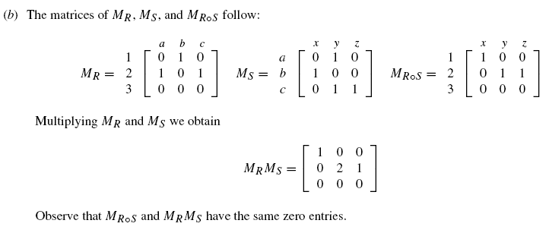
Example-11
Let A = {1, 2, 3},B = {a, b, c}, and C = {x, y, z}. Consider the following relations R and S from A to B
and from B to C, respectively.
R = {(1, b), (2, a), (2, c)} and S = {(a, y), (b, x), (c, y), (c, z)}
(a) Find the composition relation R◦S.
(b) Find the matrices MR,MS, and MR◦S of the respective relations R, S, and R◦S, and compare MR◦S to
the product MRMS.
Draw the arrow diagram of the relations R and S as in Fig. 2-7(a). Observe that 1 in A is “connected” to x in C by the path 1 → b → x; hence (1, x) belongs to R◦S. Similarly, (2, y) and (2, z) belong to R◦S.
We have
R◦S = {(1, x), (2, y), (2, z)}

Slide 72
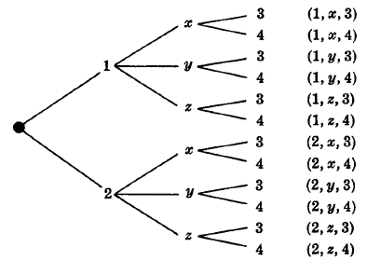
Example-12
Consider the relation R = {(1, 1), (2, 2), (2, 3), (3, 2), (4, 2), (4, 4)} on A = {1, 2, 3, 4}.
(a) Draw its directed graph. (b) Find R² = R◦R.
(a) For each (a, b) ∈ R, draw an arrow from a to b as in Fig. 2-7(b).
(b) For each pair (a, b) ∈ R, find all (b, c) ∈ R. Then (a, c) ∈ R². Thus
R2 = {(1, 1), (2, 2), (2, 3), (3, 2), (3, 3), (4, 2), (4, 3), (4, 4)}
Example 13
Given: A = {1, 2},B = {x, y, z}, and C = {3, 4}. Find: A × B × C using tree diagram.

Slide 73
EXAMPLE 14 What is the composite of the relations R and S, where R is the relation from {1, 2, 3} to {1, 2, 3, 4} with R = {(1, 1), (1, 4), (2, 3), (3, 1), (3, 4)} and S is the relation from {1, 2, 3, 4} to {0, 1, 2} with S = {(1, 0), (2, 0), (3, 1), (3, 2), (4, 1)}?
Solution: S ◦R is constructed using all ordered pairs in R and ordered pairs in S, where the second element of the ordered pair in R agrees with the first element of the ordered pair in S. For example, the ordered pairs (2, 3) in R and (3, 1) in S produce the ordered pair (2, 1) in S ◦R. Computing all the ordered pairs in the composite, we find S ◦R = {(1, 0), (1, 1), (2, 1), (2, 2), (3, 0), (3, 1)}.
EXAMPLE 15
Let R = {(1, 1), (2, 1), (3, 2), (4, 3)}. Find the powers R^{n}, n = 2, 3, 4, . . . .
Solution: Because R² = R ◦R, we find that R² = {(1, 1), (2, 1), (3, 1), (4, 2)}. Furthermore, because R³ = R² ◦R, R³ = {(1, 1), (2, 1), (3, 1), (4, 1)}. Additional computation shows that R4 is the same as R³, so R⁴ = {(1, 1), (2, 1), (3, 1), (4, 1)}. It also follows that R^{n} = R³for n = 5, 6, 7, . . . . The reader should verify this.

Slide 74
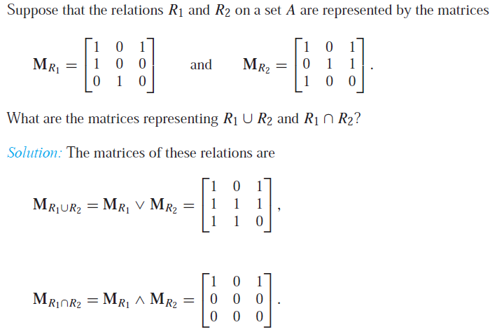
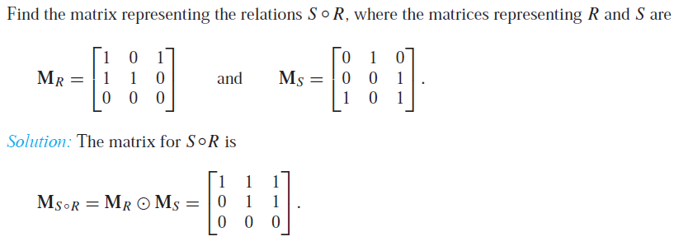
Example-16
Formula
M_{S ◦R} = M_{R} M_{S}
Example-17

Slide 75
DEFINITION 3 A relation R on a set A is called reflexive if (a, a) ∈ R for every element a ∈ A.
EXAMPLE 18 Consider the following relations on {1, 2, 3, 4}:
R1 = {(1, 1), (1, 2), (2, 1), (2, 2), (3, 4), (4, 1), (4, 4)},
R2 = {(1, 1), (1, 2), (2, 1)},
R3 = {(1, 1), (1, 2), (1, 4), (2, 1), (2, 2), (3, 3), (4, 1), (4, 4)},
R4 = {(2, 1), (3, 1), (3, 2), (4, 1), (4, 2), (4, 3)},
R5 = {(1, 1), (1, 2), (1, 3), (1, 4), (2, 2), (2, 3), (2, 4), (3, 3), (3, 4), (4, 4)},
R6 = {(3, 4)}.
Which of these relations are reflexive?
Solution: The relations R3 and R5 are reflexive because they both contain all pairs of the form (a, a), namely, (1, 1), (2, 2), (3, 3), and (4, 4). The other relations are not reflexive because they do not contain all of these ordered pairs. In particular, R1, R2, R4, and R6 are not reflexive because (3, 3) is not in any of these relations.
EXAMPLE 19 Is the “divides” relation on the set of positive integers reflexive?
Solution: Because a | a whenever a is a positive integer, the “divides” relation is reflexive.
DEFINITION 4 A relation R on a set A is called symmetric if (b, a) ∈ R whenever (a, b) ∈ R, for all a, b ∈ A. A relation R on a set A such that for all a, b ∈ A, if (a, b) ∈ R and (b, a) ∈ R, then a = b is called antisymmetric.

Slide 76
EXAMPLE 20 Is the “divides” relation on the set of positive integers symmetric? Is it antisymmetric?
Solution: This relation is not symmetric because 1| 2, but 2 | 1. It is antisymmetric, for if a and b are positive integers with a |b and b |a, then a =b
DEFINITION 5 A relation R on a set A is called transitive if whenever (a, b) ∈ R and (b, c) ∈ R, then (a, c) ∈ R, for all a, b, c ∈ A.
EXAMPLE 21 Is the “divides” relation on the set of positive integers transitive?
Solution: Suppose that a divides b and b divides c. Then there are positive integers k and l such that b = ak and c = bl. Hence, c = a(kl), so a divides c. It follows that this relation is transitive.
DEFINITION 6
A relation R on a set S is called a partial ordering or partial order if it is reflexive, antisymmetric, and transitive. A set S together with a partial ordering R is called a partially ordered set, or poset, and is denoted by (S,R). Members of S are called elements of the poset.
EXAMPLE 22 Show that the “greater than or equal” relation (≥) is a partial ordering on the set of integers.
Solution: Because a ≥ a for every integer a, ≥ is reflexive. If a ≥ b and b ≥ a, then a = b. Hence, ≥ is antisymmetric. Finally, ≥ is transitive because a ≥ b and b ≥ c imply that a ≥ c. It follows that ≥ is a partial ordering on the set of integers and (Z, ≥) is a poset.
EXAMPLE 23 The divisibility relation | is a partial ordering on the set of positive integers, because it is reflexive, antisymmetric, and transitive, as was shown in Section 9.1. We see that (Z+ , |) is a
poset. Recall that (Z+ denotes the set of positive integers.)
EXAMPLE 24 Show that the inclusion relation ⊆ is a partial ordering on the power set of a set S.
Solution: BecauseA ⊆ AwheneverAis a subset of S,⊆ is reflexive. It is antisymmetric because A ⊆ B and B ⊆ A imply that A = B. Finally, ⊆ is transitive, because A ⊆ B and B ⊆ C imply that A ⊆ C. Hence, ⊆ is a partial ordering on P(S), and (P (S),⊆) is a poset.

Slide 77
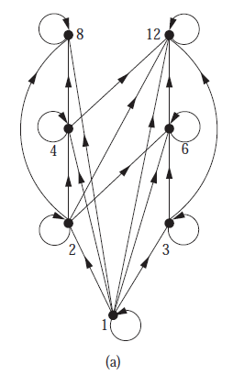
Examle-25
Draw the Hasse diagram representing the partial ordering {(a, b) |a divides b} on {1, 2, 3, 4, 6, 8, 12}.
Solution: All the possible ordered pairs: (1,1), (1,2), (1,3), (1,4), (1,6), (1,8), (1,12), (2,2), (2,4), (2,6), (2,8), (2,12), (3,3), (3,6), (3, 12), (4,4), (4,8), (4,12), (6,6), (6,12), (8,8), (12,12). The directed graph of the relation is shown in fig.(a)

Slide 78
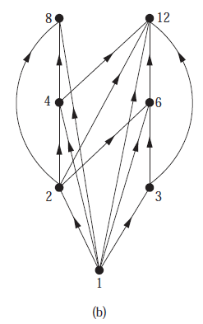
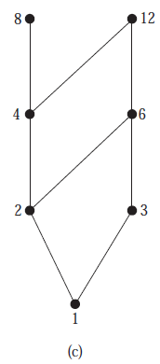
Remove all loops, as shown in Figure (b). Then delete all the edges implied by the transitive property. These are (1, 4), (1, 6), (1, 8), (1, 12), (2, 8), (2, 12), and (3, 12). Arrange all edges to point upward, and delete all arrows to obtain the Hasse diagram. The resulting Hasse diagram is shown in Figure (c).

Slide 79
There is no element a like (8, a) (12, a) on the poset(S, ≤) i.e. 8 and 12 is not connected to any element greater than them. These two elements are on the top of the Hasse diagram and is not connected to any element greater them any of them. 8 and 12 are the maximal of the relation.
Similarly there is no element b like (b, 1) i.e. . 1 is not connected to any element less then it called minimal shown at the bottom of the Hasse diagram.
If there is only one maximal then called greatest element.
If there is only one minimal then called least element.

Slide 80
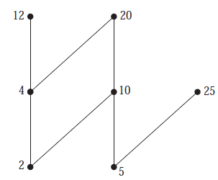
EXAMPLE 26 Which elements of the poset ({2, 4, 5, 10, 12, 20, 25}, |) are maximal, and which are minimal?
Solution: The Hasse diagram in Figure below for this poset shows that the maximal elements are 12, 20, and 25, and the minimal elements are 2 and 5.
EXAMPLE 27 Let S be a set. Determine whether there is a greatest element and a least element in the poset (P (S),⊆).
Solution: The least element is the empty set, because ∅ ⊆ T for any subset T of S. The set S is the greatest element in this poset, because T ⊆ S whenever T is a subset of S.
EXAMPLE 28 Is there a greatest element and a least element in the poset (Z+, |)?
Solution: The integer 1 is the least element because 1|n whenever n is a positive integer. Because there is no integer that is divisible by all positive integers, there is no greatest element.

Slide 81
Sometimes it is possible to find an element that is greater than or equal to all the elements in a subset A of a poset (S, ≤ ). If u is an element of S such that a ≤ u for all elements a ∈ A, then u is called an upper bound of A. Likewise, there may be an element less than or equal to all the elements in A. If l is an element of S such that l a for all elements a ∈ A, then l is called a lower bound of A.
Let the poset({1,2,3,4,5,6,7, 8}, ≤ ) ; where S= {1,2,3,4,5,6,7,8}, let us assume a subset of S is A={3,4, 5}.
(3,3), (3,4), (3,5), (3,6), (3,7) , (3,8) ∈ S
(4,4), (4,5) , (4,6) (4,7) , (4,8) ∈ S
(5,5), (5,6) , (5,7) (5,8) ∈ S
The upper bound of A is 5, 6, 7, 8 and the least upper bound is 5.
(1,3), (2,3), (3,3) ∈ S
(1,4), (2,4), (3,4), (4,4) ∈ S
(1,5), (2,5) (3,5) (4,5) (5,5) ∈ S
The lower bound of A is 1,2 and 3 and the greatest lower bound of A is 3.

Slide 82
Example-29
Answer these questions for the poset ({3, 5, 9, 15, 24, 45}, |).
a) Find the maximal elements.
b) Find the minimal elements.
c) Is there a greatest element?
d) Is there a least element?
e) Find all upper bounds of {3, 5}.
f ) Find the least upper bound of {3, 5}, if it exists.
g) Find all lower bounds of {15, 45}.
h) Find the greatest lower bound of {15, 45}, if it exists.
Ans. The relations, R={(3,9),(3,15), (3, 24), (3, 45), (5, 15), (5,45), (9, 45), (15, 45)}.
24, 45
3, 5
No
No
(e) A={3, 5}
(3,3),(3,9),(3,15),(3,24), (3,45) ∈ R
(5,15), (5,45) ∈ R
The upper bounds 15, 45
(f) 15
(3, 15), (5, 15), (15, 15) ∈ R
(3, 45), (5, 45), (15, 45), (45, 45) ∈ R
The lower bound 3,5, 15
(h) 15

Slide 83
Lattices
A partially ordered set in which every pair of elements has both a least upper bound and a greatest lower bound is called a lattice. Lattices have many special properties. Furthermore, lattices are used in many different applications such as models of information flow and play an important role in Boolean algebra.
EXAMPLE 30 Determine whether the posets represented by each of the Hasse diagrams in Figure 8 are lattices.
Solution: The posets represented by the Hasse diagrams in (a) and (c) are both lattices because in each poset every pair of elements has both a least upper bound and a greatest lower bound, as the reader should verify. On the other hand, the poset with the Hasse diagram shown in (b) is not a lattice, because the elements b and c have no least upper bound. To see this, note that each of the elements d, e, and f is an upper bound, but none of these three elements precedes the other two with respect to the ordering of this poset

Slide 84
EXAMPLE 31 Is the poset (Z+ , |) a lattice?
Solution: Let a and b be two positive integers. The least upper bound and greatest lower bound of these two integers are the least common multiple and the greatest common divisor of these integers, respectively, as the reader should verify. It follows that this poset is a lattice.
EXAMPLE 32 Determine whether the posets ({1, 2, 3, 4, 5}, |) and ({1, 2, 4, 8, 16}, |) are lattices.
Solution: Because 2 and 3 have no upper bounds in ({1, 2, 3, 4, 5}, |), they certainly do not have a least upper bound. Hence, the first poset is not a lattice. Every two elements of the second poset have both a least upper bound and a greatest lower bound. The least upper bound of two elements in this poset is the larger of the elements and the greatest lower bound of two elements is the smaller of the elements, as the reader should verify. Hence, this second poset is a lattice
EXAMPLE 33 Determine whether (P (S),⊆) is a lattice where S is a set.
Solution: Let A and B be two subsets of S. The least upper bound and the greatest lower bound of A and B are A ∪ B and A ∩ B, respectively, as the reader can show. Hence, (P (S),⊆) is a lattice

Slide 85
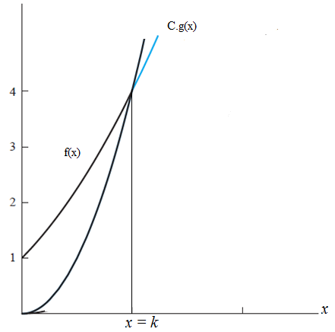
Big-O Notation
Let f and g be functions from the set of integers or the set of real numbers to the set of real numbers. We say that f (x) is O(g(x)) if there are constants C and k such that
|f (x)| ≤ C|g(x)|
whenever x > k. [This is read as “f (x) is big-oh of g(x).”]

Slide 86
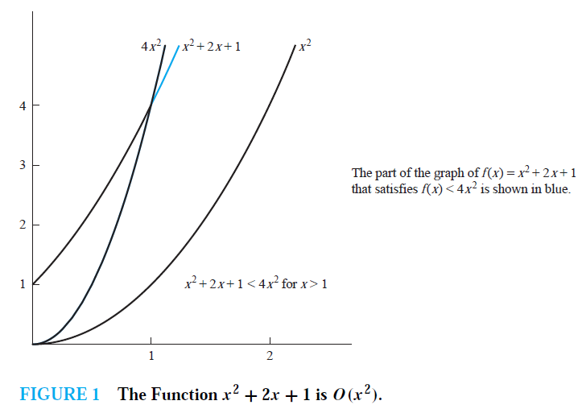
EXAMPLE 1 Show that f (x) = x² + 2x + 1 is O(x²).
Solution: When x > 1 then x < x² and 1 < x² when x > 1. It follows that 0 ≤ x² + 2x + 1 ≤ x² + 2x² + x² = 4x²
Whenever x > 1, x² + 2x + 1 < 4x² as shown in Figure 1. Consequently, we can take C = 4 and k = 1 as witnesses to show that f (x) is O(x²).
EXAMPLE 2 Show that 7x² is O(x³).
Solution: Note that when x > 7, we have 7x² < x³. Consequently, we can take C = 1 and k = 7 as witnesses to establish the relationship 7x² is O(x³).
Alternate proof
Alternatively, when x > 1, we have 7x² < 7x³, so that C = 7 and k = 1 are also witnesses to the relationship 7x² is O(x³).
EXAMPLE 3 How can big-O notation be used to estimate the sum of the first n positive integers?
Solution: Because each of the integers in the sum of the first n positive integers does not exceed
n, it follows that
1 + 2+・ ・ ・+n ≤ n + n +・ ・ ・+ n = n².
From this inequality it follows that 1 + 2 + 3+・ ・ ・+n is O(n²), taking C = 1 and k = 1 as witnesses.

Slide 87
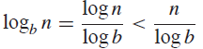
EXAMPLE 4 Give big-O estimates for the factorial function and the logarithm of the factorial function.
Solution: A big-O estimate for n! can be obtained by noting that each term in the product does
not exceed n. Hence,
n! = 1 ・ 2 ・ 3 ・ ・ ・ ・ ・ n
≤ n ・ n ・ n ・ ・ ・ ・ ・ n
= n^{n}.
This inequality shows that n! is O(n^{n}), taking C = 1 and k = 1 as witnesses.
Taking logarithms of both sides of the inequality established for n!, we obtain log n! ≤ log n^{n} = n log n.
This implies that log n! is O(n log n), again taking C = 1 and k = 1
EXAMPLE 5 Show that log n is O(n).
Solution: Using the inequality n < 2^{n}, we quickly can conclude that n is O(2^{n}) by taking k = C = 1 as witnesses.
Taking logarithms (base 2) of both sides of this inequality shows that logn < n.
It follows that log n is O(n).
If we have logarithms to a base b, where b is different from 2, we still have log_{b}n is O(n) because
whenever n is a positive integer.We take C = 1/ logb and k = 1 as witnesses

Slide 88
Big-Omega Notation
Let f and g be functions from the set of integers or the set of real numbers to the set of real numbers. We say that f (x) is (g(x)) if there are positive constants C and k such that |f (x)| ≥ C|g(x)|
whenever x > k. [This is read as “f (x) is big-Omega of g(x).”]
EXAMPLE 6
The function f (x) = 8x³ + 5x² + 7 is Ω(g(x)), where g(x) is the function g(x) = x3. This is easy to see because f (x) = 8x³ + 5x² + 7 ≥ 8x³ for all positive real numbers x.

Slide 89
GRAPH
A graph G = (V ,E) consists of V , a nonempty set of vertices (or nodes) and E, a set of edges. Each edge has either one or two vertices associated with it, called its endpoints. An edge is said to connect its endpoints.
(i) V consists of vertices A, B, C, D. Therefore V={A, B, C, D}
(ii) E consists of edges e₁ = {A,B}, e₂ = {B,C}, e₃ = {C,D}, e₄ = {A,C}, e₅ = {B,D}.

Slide 90
A graph in which each edge connects two different vertices and where no two edges connect the same pair of vertices is called a simple graph.
graphs that have more than one edge connecting the same pair of vertices. Graphs that may have multiple edges connecting the same vertices are called multigraphs.
Graphs that may include loops, and possibly multiple edges connecting the same pair of vertices or a vertex to itself, are sometimes called pseudographs.
A directed graph (or digraph) (V ,E) consists of a nonempty set of vertices V and a set of directed edges (or arcs) E. Each directed edge is associated with an ordered pair of vertices. The directed edge associated with the ordered pair (u, v) is said to start at u and end at v.
When a directed graph has no loops and has no multiple directed edges, it is called a simple directed graph.
Directed graphs that may have multiple directed edges from a vertex to a second (possibly the same) vertex are used to model such networks. We called such graphs directed multigraphs.

Slide 91
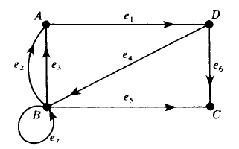
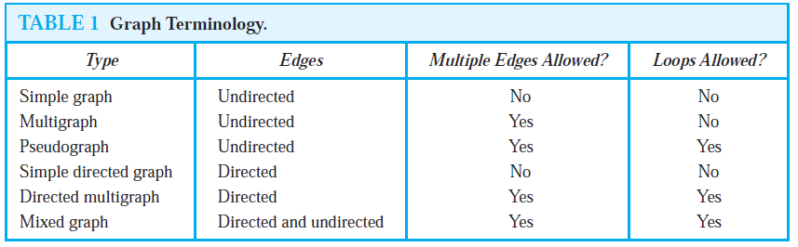
Consider the directed graph G pictured in Fig. below. It consists of four vertices, A, B, C, D, that is, V (G) = {A,B,C,D} and the seven following edges:
E(G) = {e₁, e₂, . . . , e₇} = {(A,D), (B, A), (B, A), (D,B), (B,C), (D,C), (B, B)}
The edges e₂ and e₃ are said to be parallel since they both begin at B and end at A. The edge e₇ is a loop since it begins and ends at B.

Slide 92
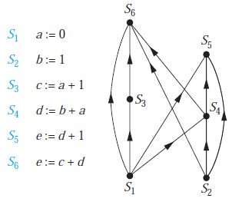
Precedence Graphs
Computer programs can be executed more rapidly by executing certain statements concurrently. It is important not to execute a statement that requires results of statements not yet executed. The dependence of statements on previous statements can be represented by a directed graph. Each statement is represented by a vertex, and there is an edge from one statement to a second statement if the second statement cannot be executed before the first statement. This resulting graph is called a precedence graph.
Example-1

Slide 93
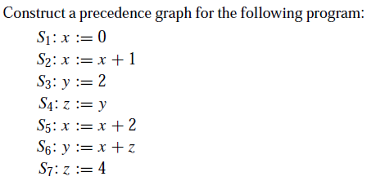
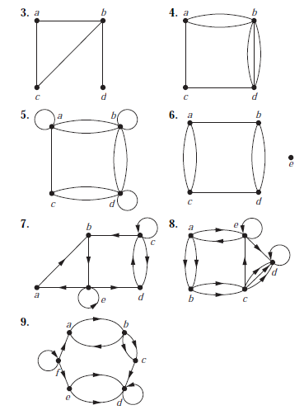
Exercises-2
determine whether the graph shown has directed or undirected edges, whether it has multiple edges, and whether it has one or more loops. Use your answers to determine the type of graph in Table 1 this graph is.
Exercises-1

Slide 94
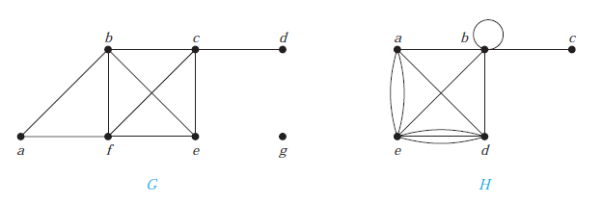
The degree of a vertex in an undirected graph is the number of edges incident with it, except that a loop at a vertex contributes twice to the degree of that vertex. The degree of the vertex v is denoted by deg(v).
Example-2
What are the degrees of the vertices in the graphs G and H displayed in Figure 1?
Solution: In G, deg(a) = 2, deg(b) = deg(c) = deg(f ) = 4, deg(d ) = 1, deg(e) = 3, and deg(g) = 0. H, deg(a) = 4, deg(b) = deg(e) = 6, deg(c) = 1, and deg(d ) = 5.

Slide 95
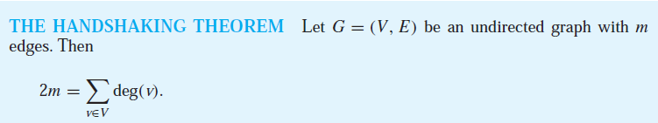
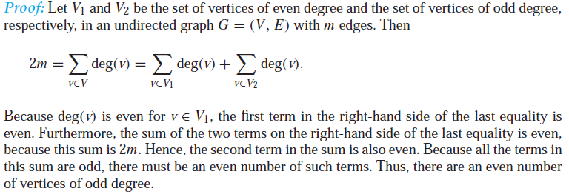
EXAMPLE 3
How many edges are there in a graph with 10 vertices each of degree six?
Solution: Because the sum of the degrees of the vertices is 6 ・ 10 = 60, it follows that 2m = 60 where m is the number of edges. Therefore, m = 30.
Theorem
An undirected graph has an even number of vertices of odd degree.

Slide 96
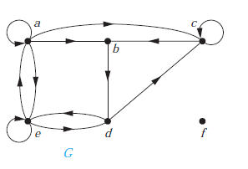
In a graph with directed edges the in-degree of a vertex v, denoted by deg⁻(v), is the number of edges with v as their terminal vertex. The out-degree of v, denoted by deg⁺(v), is the number of edges with v as their initial vertex. (Note that a loop at a vertex contributes 1 to both the in-degree and the out-degree of this vertex.)
EXAMPLE 4 Find the in-degree and out-degree of each vertex in the graph G with directed edges shown in Figure 2.
Solution: The in-degrees in G are deg⁻(a) = 2, deg⁻(b) = 2, deg⁻(c) = 3, deg⁻(d) = 2, deg⁻(e) = 3,
and deg⁻(f ) = 0.
The out-degrees are deg⁺(a) = 4, deg⁺(b) = 1, deg⁺(c) = 2,deg⁺(d) = 2, deg⁺(e) = 3, and deg⁺(f ) = 0.

Slide 97
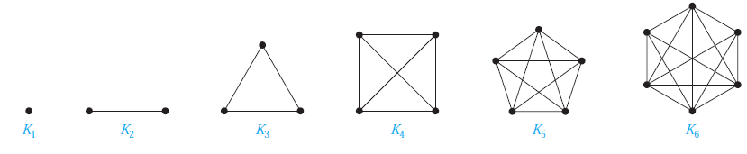
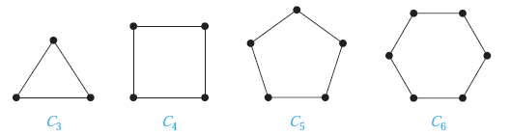
Some Special Simple Graphs
Complete Graphs
A complete graph on n vertices, denoted by Kn, is a simple graph that contains exactly one edge between each pair of distinct vertices. The graphs K_{n}, for n = 1, 2, 3, 4, 5, 6, are displayed in Figure below. A simple graph for which there is at least one pair of distinct vertex not connected by an edge is called noncomplete.
Cycles
A cycle C_{n}, n ≥ 3, consists of n vertices v₁, v₂, . . . , v_{n} and edges {v₁, v₂}, {v₂, v₃}, . . . , {v_{n−1}, v_{n}}, and {v_{n}, v₁}. The cycles C₃, C₄, C₅, and C₆ are displayed in Figure below.

Slide 98
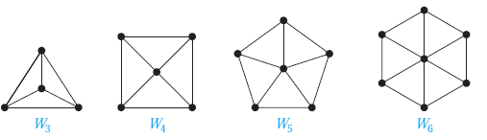

Wheels
We obtain a wheel W_{n} when we add an additional vertex to a cycle C_{n}, for n ≥ 3, and connect this new vertex to each of the n vertices in C_{n}, by new edges. The wheels W₃, W₄, W₅, and W₆ are displayed in Figure below.
n-Cubes
An n-dimensional hypercube, or n-cube, denoted by Q_{n}, is a graph that has vertices representing the 2^{n} bit strings of length n. Two vertices are adjacent if and only if the bit strings that they represent differ in exactly one bit position. We display Q₁, Q₂, and Q₃ in Figure below.

Slide 99


Bipartite
A simple graph G is called bipartite if its vertex set V can be partitioned into two disjoint sets V₁ and V₂ such that every edge in the graph connects a vertex in V₁ and a vertex in V₂ (so that no edge in G connects either two vertices in V₁ or two vertices in V₂). When this condition holds, we call the pair (V₁, V₂) a bipartition of the vertex set V of G.
Complete Bipartite Graphs
A complete bipartite graph K_{m,n} is a graph that has its vertex set partitioned into two subsets of m and n vertices, respectively with an edge between two vertices if and only if one vertex is in the first subset and the other vertex is in the second subset. The complete bipartite graphs K_{2,3}, K_{3,3}, K_{3,5}, and K_{2,6} are displayed in Figure below.
A path or circuit of a graph is simple if it does not contain the same edge more than once.

Slide 100

Euler Paths and Circuits
The town of Königsberg, Prussia (now called Kaliningrad and part of the Russian republic), was divided into four sections by the branches of the Pregel River.
The townspeople took long walks through town on Sundays. They wondered whether it was possible to start at some location in the town, travel across all the bridges once without crossing any bridge twice, and return to the starting point. The Swiss mathematician Leonhard Euler solved this problem.

Slide 101

Euler studied this problem using the multigraph obtained when the four regions are represented by vertices and the bridges by edges. This multigraph is shown in Figure below.
The question becomes: Is there a simple circuit in this multigraph that contains every edge?
An Euler circuit in a graph G is a simple circuit containing every edge of G. An Euler path in G is a simple path containing every edge of G.
Theorem
A connected multigraph with at least two vertices has an Euler circuit if and only if each of its vertices has even degree.
Theorem
A connected multigraph has an Euler path but not an Euler circuit if and only if it has exactly two vertices of odd degree.

Slide 102

EXAMPLE 4
Which graphs shown in Figure below have an Euler path?
Solution:G₁ contains exactly two vertices of odd degree, namely, b and d. Hence, it has an Euler path that must have b and d as its endpoints. One such Euler path is d, a, b, c, d, b. Similarly,G₂ has exactly two vertices of odd degree, namely, b and d. So it has an Euler path that must have b and d as endpoints. One such Euler path is b, a, g, f, e, d, c, g, b, c, f, d. G3 has no Euler path because it has six vertices of odd degree.
Hamilton Paths and Circuits
A simple path in a graph G that passes through every vertex exactly once is called a Hamilton path, and a simple circuit in a graph G that passes through every vertex exactly once is called a Hamilton circuit.
DIRAC’S THEOREM
If G is a simple graph with n vertices with n ≥ 3 such that the degree of every vertex in G is at least n/2, then G has a Hamilton circuit.

Slide 103

TREE
A tree is a connected undirected graph with no simple circuits.
A rooted tree is a tree in which one vertex has been designated as the root and every edge is directed away from the root.
EXAMPLE 1
Which of the graphs shown in Figure below are trees?
Solution: G₁ and G₂ are trees, because both are connected graphs with no simple circuits. G₃ is not a tree because e, b, a, d, e is a simple circuit in this graph. Finally, G₄ is not a tree because it is not connected.

Slide 104

A rooted tree is called an m-ary tree if every internal vertex has no more than m children. The tree is called a full m-ary tree if every internal vertex has exactly m children. An m-ary tree with m = 2 is called a binary tree.
EXAMPLE 2
Are the rooted trees in Figure below full m-ary trees for some positive integer m?
Solution: T1 is a full binary tree because each of its internal vertices has two children. T2 is a full 3-ary tree because each of its internal vertices has three children. In T3 each internal vertex has five children, so T3 is a full 5-ary tree. T4 is not a full m-ary tree for any m because some of its internal vertices have two children and others have three children.

Slide 105

THEOREM
A full m-ary tree with i internal vertices contains n = mi + 1 vertices.
Proof:
Every vertex, except the root, is the child of an internal vertex. Because each of the i internal vertices has m children, there are mi vertices in the tree other than the root. Therefore, the tree contains n = mi + 1 vertices.
THEOREM

Slide 106

Example-3
a) Which vertex is the root?
b) Which vertices are internal?
c) Which vertices are leaves?
d) Which vertices are children of j?
e) Which vertex is the parent of h?
f ) Which vertices are siblings of o?
g) Which vertices are ancestors of m?
h) Which vertices are descendants of b?
3. a) a
b) a, b, c, d, f , h, j , q, t
c) e, g, i, k,l,m, n, o, p, r, s, u
d) q, r
e) c f) p g) f , b, a h) e, f , l,m, n

Slide 107
Example-4
How many edges does a tree with 10,000 vertices have?
Ans. e = v-1 = 9999
Example-5
Suppose 1000 people enter a chess tournament. Use a rooted tree model of the tournament to determine how many games must be played to determine a champion, if a player is eliminated after one loss and games are played until only one entrant has not lost.
Ans. The number of players =1000 = number of leaves of full binary tree.
The number of games = the number of internal vertices,
i = (l-1)/(m-1) = (1000-1)/(2-1) = 999
Example-6
How many vertices does a full 5-ary tree with 100 internal
vertices have?
Ans. Given, m = 5 and i =100.
For full m-ary tree, v = mi + 1 = 5 × 100 + 1 = 501.
Example-7
How many edges does a full binary tree with 1000 internal
vertices have?
Ans. m = 2, i =1000
v = mi + 1= 2001
e = v - 1 = 2000
Example-8
How many leaves does a full 3-ary tree with 100 vertices have?
m = 3, v = 100
l ={(m-1)v+1}/m = {(3-1) × 100 + 1}/3 = 201/3 = 67
A complete m-ary tree is a full m-ary tree in which every leaf is at the same level.

Slide 108
Example-9
How many vertices and how many leaves does a complete
m-ary tree of height h have?
Ans. The number of leaves = m^{h}
The number of vertices,
1 + m + m² + m³ +… … … + m^{h} = 1 × (m^{h+1}-1)/(m-1)
Example-10
How many edges are there in a forest of t trees containing
a total of n vertices?
Ans. n-t
A rooted m-ary tree of height h is balanced if all leaves are at levels h or h − 1.
Example-11
Which of the rooted trees shown in Figure 14 are balanced?
Solution: T1 is balanced, because all its leaves are at levels 3 and 4. However, T2 is not balanced, because it has leaves at levels 2, 3, and 4. Finally, T3 is balanced, because all its leaves are at
level 3.

Slide 109
Tree Traversal
Procedures for systematically visiting every vertex of an ordered rooted tree are called traversal algorithms. We will describe three of the most commonly used such algorithms, preorder traversal, inorder traversal, and postorder traversal
Preorder traversal
Let T be an ordered rooted tree with root r. If T consists only of r, then r is the preorder traversal of T . Otherwise, suppose that T1, T2, . . . , Tn are the subtrees at r from left to right in T . The preorder traversal begins by visiting r. It continues by traversing T1 in preorder, then T2 in preorder, and so on, until Tn is traversed in preorder.
(pic 1)
Inorder traversal
Let T be an ordered rooted tree with root r. If T consists only of r, then r is the inorder traversal of T . Otherwise, suppose that T1, T2, . . . , Tn are the subtrees at r from left to right. The inorder traversal begins by traversing T1 in inorder, then visiting r. It continues by traversing T2 in inorder, then T3 in inorder, . . . , and finally Tn in inorder.
(pic 2)

Slide 110
PIC 1

Slide 111
PIC 2

Slide 112
Spanning Trees
Let G be a simple graph. A spanning tree of G is a subgraph of G that is a tree containing every vertex of G.
Example-12
Find a spanning tree of the simple graph G shown in Figure below.

Slide 113
Ans. Some possible spanning tress are shown below

Slide 114

Example-13
Find a spanning tree for each of these graphs.
a) K₅ b) K_{4,4} c) K_{1,6} d) Q₃ e) C₅ f ) W₅

Slide 115
A minimum spanning tree in a connected weighted graph is a spanning tree that has the smallest possible sum of weights of its edges.
Prim’s Algorithm of minimum spanning tree
procedure Prim(G: weighted connected undirected graph with n vertices)
T := a minimum-weight edge
for i := 1 to n − 2
e := an edge of minimum weight incident to a vertex in T and not forming a
simple circuit in T if added to T
T := T with e added
return T {T is a minimum spanning tree of G}

Slide 116
Example-14
Use Prim’s algorithm to find a minimum spanning tree in the graph shown in Figure 3.
Kruskal’s Algorithm of minimum spanning tree
procedure Kruskal(G: weighted connected undirected graph with n vertices)
T := empty graph
for i := 1 to n − 1
e := any edge in G with smallest weight that does not form a simple circuit
when added to T
T := T with e added
return T {T is a minimum spanning tree of G}

Slide 117
Example-15
Use Kruskal’s algorithm to find a minimum spanning tree in the weighted graph.

Slide 118
Group and Ring
Groups, rings, and fields are the fundamental elements of a branch of mathematics known as abstract algebra, or modern algebra.
Let S be a nonempty set. An operation on S is a function ∗ from S × S into S is denoted as (S, ∗).
Let us define a set with operator • as: ( {a, b, c, d}, •) and the operation as shown in Table below.
Next we list a number of important properties of our operations.
Associative Law:
An operation ∗ on a set S is said to be associative or to satisfy the Associative Law if, for any elements a, b, c in S, we have (a ∗ b) ∗ c = a ∗ (b ∗ c)
Commutative Law:
An operation ∗ on a set S is said to be commutative or satisfy the Commutative Law if, for any elements a, b in S, a ∗ b = b ∗ a

Slide 119
EXAMPLE 1
Consider the set Z of integers. Addition and multiplication of integers are associative and commutative. On the other hand, subtraction is non associative.
For example, (8 − 4) − 3 = 1 but 8 − (4 − 3) = 7
Moreover, subtraction is not commutative since,
for example, 3 − 7 = 7 − 3.
(b) Consider the operation of matrix multiplication on the set M of n-square matrices. One can prove that matrix multiplication is associative. On the other hand, matrix multiplication is not commutative. For example,

Slide 120
Identity Element:
Consider an operation ∗ on a set S. An element e in S is called an identity element for ∗ if, for any element a in S,
a ∗ e = e ∗ a = a
More generally, an element e is called a left identity or a right identity according as e ∗ a = a or a ∗ e = a where a is any element in S.
Inverses:
Suppose an operation ∗ on a set S does have an identity element e. The inverse of an element a in S is an element b such that
a ∗ b = b ∗ a = e
EXAMPLE 2
Consider the rational numbers Q. Under addition, 0 is the identity element, and − 3 and 3 are (additive) inverses since (−3) + 3 = 3 + (−3) = 0
On the other hand, under multiplication, 1 is the identity element, and −3 and −1/3 are (multiplicative) inverses since
(−3)(−1/3) = (−1/3)(−3) = 1
Note 0 has no multiplicative inverse.
SEMIGROUPS
Let S be a nonempty set with an operation. Then S is called a semigroup if the operation is associative. If the operation also has an identity element, then S is called a monoid.
Example 3
Consider the positive integers N. Then (N, +) and (N, ×) are semigroups since addition and multiplication on N are associative. In particular, (N, ×) is a monoid since it has the identity element 1. However, (N, +) is not a monoid since addition in N has no zero element.

Slide 121
Groups
A group , sometimes denoted by {G, *} , is a set of elements with a binary operation denoted by * that associates to each ordered pair (a, b) of elements in an element (a *b) in G, such that the following axioms are obeyed.
(A1) Closure: If a and b belong to G, then a *b is also in G.
(A2) Associative: a *(b *c) = (a *b) *c for all a, b, c in G.
(A3) Identity element: There is an element e in such
that a *e = e *a = a for all a in G.
(A4) Inverse element: For each in , there is an element in
such that a *a´ = a ´*a = e.
Example 4
If R is a set of real numbers then, (R,+) is a group.
We know already that addition is a binary operation on R, so ‘closure’ holds.
We know addition of real numbers is associative.
What is the identity element? We want an element e ε R so that a + e = e + a = a for all a ε R. It is clear that e = 0 works and is the only possible choice.
Moreover, the (additive) inverse of a is -a: a + (-a) = (-a) + a = 0 = e.

Slide 122
Example 5
All the groups we have met so far are infinite. Here is an example of a finite group. Let A = {+1,-1}. Then (A, *) is a group (where the operator * is multiplication).
Example 6
Let B = {1, i ,-1,-i }, where i =√(-1). Then (B, *) is another example of a finite group.
Example 7
Let C = {1, i }. Then (C, *) is not a group since it isn’t closed; for example i * i = -1 ε C.
Abelian Groups
We say that a group (G, ○) is abelian if (in addition to the defining properties (i)–(iv) of a group) it also satisfies:
(v) (commutativity) for all a, b ε G, a ○ b = b ○ a.

Slide 123

EXAMPLE 8
The nonzero rational numbers Q\{0} form an abelian group under multiplication. The number 1 is the identity element and q/p is the multiplicative inverse of the rational number p/q.
(b) Let S be the set of 2 × 2 matrices with rational entries under the operation of matrix multiplication. Then S is not a group since inverses do not always exist.
However, let G be the subset of 2 × 2 matrices with a nonzero determinant. Then G is a group under matrix multiplication. The identity element is

Slide 125
Example-9
Consider the set Q of rational numbers, and let ∗ be the operation on Q defined by: a ∗ b = a + b − ab
(a) Find: (i) 3 ∗ 4; (ii) 2 ∗ (−5); (iii) 7 ∗ (1/2).
(b) Is (Q, ∗) a semigroup? Is it commutative?
(c) Find the identity element for ∗.
(d) Do any of the elements in Q have an inverse? What is it?
Ans.
a) (i) 3 ∗ 4 = 3 + 4 − 3(4) = 3 + 4 − 12 = −5
(ii) 2 ∗ (−5) = 2 + (−5) + 2(−5) = 2 − 5 + 10 = 7
(iii) 7 ∗ (1/2) = 7 + (1/2) − 7(1/2) = 4
(c) An element e is an identity element if a ∗ e = a for every a ∈ Q. Compute as follows:
a ∗ e = a, a + e − ae = a, e − ea = 0, e(1 − a) = 0, e= 0
Accordingly, 0 is the identity element.
(d) In order for a to have an inverse x, we must have a ∗ x = 0 since 0 is the identity element by Part (c).
Compute as follows:
a ∗ x = 0, a + x − ax = 0, a = ax − x, a = x(a − l), x = a/(a − l)
Thus if a ≠ 1, then a has an inverse and it is a/(a − 1).
(b) We have:
(a ∗ b) ∗ c
=(a + b − ab) ∗ c
= (a + b − ab) + c − (a + b − ab)c
=a + b − ab + c − ac − bc + abc
= a + b + c − ab − ac − bc + abc
a ∗ (b ∗ c)
= a ∗ (b + c − bc) = a + (b + c − bc) − a(b + c − bc)
= a + b + c − bc − ab − ac + abc
Hence ∗ is associative and (Q, ∗) is a semigroup. Also
a ∗ b = a + b − ab = b + a − ba = b ∗ a
(Hence (Q, ∗) is a commutative semigroup.

Slide 126

Example 10
Consider the group G = {1, 2, 3, 4, 5, 6, *} under multiplication modulo 7.
(a) Find the multiplication table of G. (b) Find 2⁻¹, 3⁻¹, 6⁻¹.
Ans.
(a) To find a ∗ b in G, find the remainder when the product ab is divided by 7.
For example, 5・6 = 30 which yields a remainder of 2 when divided by 7; hence 5 ∗6 = 2 in G. The multiplication table of G appears in Fig. below.
(b) Note first that 1 is the identity element of G. Recall that a⁻¹ is that element of G such that aa⁻¹ =1. Hence 2⁻¹ = 4, 3⁻¹ = 5 and 6⁻¹ = 6.

Slide 127
Symmetric Group S_{n}
A one-to-one mapping σ of the set S = {1, 2, …, n} onto itself is called a permutation. Such a permutation may be denoted as follows where j_{i} = σ(i):
The set of all such permutations is denoted by S_{n}, and there are n! possible elements of set S_{n}. The composition and inverses of permutations in S_{n} belong to S_{n}, and the identity function ε belongs to S_{n}. Thus S_{n} forms a group (S_{n}, ◊) called the symmetric group of degree n and order n!.

Slide 128
Let us consider a set, S = {1, 2, 3}.
The symmetric group S₃ has 3! = 6 elements as follows:
The multiplication table of S₃ appears in Fig. below
({ε,σ₁,Φ₂} ,◊), ({ε,σ₃,Φ₁} ,◊), ({ε,σ₂} ,◊) etc are all permutation group of degree 3 and order 6.
({ε,σ₁, σ₂ ,σ₃, Φ₁, Φ₂} ,◊), is symmetric group of degree 3 and order 6.

Slide 129


By considering the symmetries of regular polygons we obtain certain other permutation groups called dihedral group. For this purpose, let us first consider an equilateral triangle whose vertices are denoted as A, B and C. Now consider all possible rotation and reflections which leave the final position of the triangle unchanged from its original position except for the renaming of vertices. Thus the dihedral group is (D₃, ◊) obtained from rotation and reflection of a triangle.
Multiplication table of S₃

Slide 130
Example 11

Slide 131
Example-12
Let S be the square in Fig. below, with its center at the origin 0. Note that the vertices of S are numbered counterclockwise from 1 to 4.
Determine 8 elements of D₄ by rotation and reflection.
There are eight symmetries as follows. For α = 0◦, 90◦, 180◦, 270◦, let σ(α) be the symmetry obtained by rotating S about its center α degrees, and let τ(α) be the symmetry obtained by reflecting S about the y-axis and then rotating S about its center α degrees.

Slide 132

Now D₄ = {σ(0⁰), σ(90⁰), σ(180⁰), σ(270⁰), τ(0⁰), τ(90⁰), τ(180⁰), τ(270⁰)}
Therefore (D₄, ◊) is a group of order 8 and degree 4.

Slide 133
Rings
A ring , sometimes denoted by {R, +, *}, is a set of elements with two binary operations, called addition and multiplication such that for all a, b, c in R the following axioms are obeyed.
(A1–A5) is an abelian group with respect to addition; that is, satisfies axioms A1 through A5. For the case of an additive group, we denote the identity element as 0 and the inverse of a as –a.
(M1) Closure under multiplication: If a and b belong to R, then ab is also in R.
(M2) Associativity of multiplication: a(bc) = (ab)c for all a, b, c in R.
(M3) Distributive laws: a(b + c) = ab + ac for all a, b, c in R.
(a + b)c = ac + bc for all a, b, c in R.
A ring is said to be commutative if it satisfies the following additional condition:
(M4) Commutativity of multiplication: ab = ba for all a, b in R.

Slide 134

Counting
Counting problems arise throughout mathematics and computer science. For example, we must count the successful outcomes of experiments and all the possible outcomes of these experiments to determine probabilities of discrete events. We need to count the number of operations used by an algorithm to study its time complexity.
PERMUTATIONS
Any arrangement of a set of n objects in a given order is called a permutation of the object (taken all at a time). Any arrangement of any r ≤ n of these objects in a given order is called an “r- permutation” or “a permutation of the n objects taken r at a time.”
EXAMPLE 1 Find the number m of permutations of six objects, say, A, B, C, D, E, F, taken three at a time.
Ans. P(6, 3) = 6 ・ 5 ・ 4 = 120

Slide 135

EXAMPLE 2 Find the number m of seven-letter words that can be formed using the letters of the word “BENZENE.”
We seek the number of permutations of 7 objects of which 3 are alike (the three E’s), and 2 are alike (the two N’s)
EXAMPLE 3 How many permutations of the letters ABCDEFGH contain the string ABC ?
Solution: Because the letters ABC must occur as a block, we can find the answer by finding the number of permutations of six objects, namely, the block ABC and the individual letters D, E, F, G, and H. Because these six objects can occur in any order, there are 6! = 720 permutations of the letters ABCDEFGH in which ABC occurs as a block.

Slide 136
Example 4
A class contains 8 students. Find the number n of samples of size 3:(a)With replacement; (b)Without replacement.
Solve: (a) Each student in the ordered sample can be chosen in 8 ways; hence, there are n = 8.8 .8 = 83 = 512 samples of size 3 with replacement.
(b) The first student in the sample can be chosen in 8 ways, the second in 7 ways, and the last in 6 ways. Thus, there are n = 8 .7 .6 = 336 samples of size 3 without replacement.
Ordered Samples
Many problems are concerned with choosing an element from a set S, say, with n elements. When we choose one element after another, say, r times, we call the choice an ordered sample of size r. We consider two cases.
(1) Sampling with replacement
Here the element is replaced in the set S before the next element is chosen. Thus, each time there are n ways to choose an element (repetitions are allowed). The Product rule tells us that the number of such samples is:
n・ n ・ n ・ ・ ・ n ・ n(r factors) = n^{r}
(2) Sampling without replacement
Here the element is not replaced in the set S before the next element is chosen. Thus, there is no repetition in the ordered sample. Such a sample is simply an r-permutation. Thus the number of such samples is:
P(n, r) = n(n − 1) (n − 2) ・ ・ ・ (n − r + 1) = n!/(n − r)!

Slide 137
EXAMPLE 5
Three cards are chosen one after the other from a 52-card deck. Find the number m of ways this can be done: (a) with replacement; (b) without replacement.
(a) Each card can be chosen in 52 ways. Thus m = 52(52)(52) = 140 608.
(b) Here there is no replacement. Thus the first card can be chosen in 52 ways, the second in 51 ways, and the third in 50 ways. Therefore: m = P(52, 3) = 52(51)(50) = 132 600
COMBINATIONS
Let S be a set with n elements. A combination of these n elements taken r at a time is any selection of r of the elements where order does not count. Such a selection is called an r-combination; it is simply a subset of S with r elements. The number of such combinations will be denoted by
C(n, r) (other texts may use _{n}C_{r}, C_{n,r} , or C^{n}_{r} ).
EXAMPLE 6
A farmer buys 3 cows, 2 pigs, and 4 hens from a man who has 6 cows, 5 pigs, and 8 hens. Find the number m of choices that the farmer has.
Ans.
The farmer can choose the cows in C(6, 3) ways, the pigs in C(5, 2) ways, and the hens in C(8, 4) ways.
Thus the number m of choices follows:

Slide 138


Example 7
A class contains 10 students with 6 men and 4 women. Find the number n of ways to:
(a) Select a 4-member committee from the students.
(b) Select a 4-member committee with 2 men and 2 women.
(c) Elect a president, vice president, and treasurer.
Ans.
(a) This concerns combinations, not permutations, since order does not count in a committee. There are “10 choose 4” such committees. That is:
(b) The 2 men can be chosen from the 6 men in C(6, 2) ways, and the 2 women can be chosen from the 4 women in
C(4, 2) ways. Thus, by the Product Rule:
(c) This concerns permutations, not combinations, since order does count. Thus,
n = P(6, 3) = 6 ・ 5 ・ 4 = 120

Slide 139
Example-8
Suppose that there are 9 faculty members in the mathematics department and 11 in the computer science department. How many ways are there to select a committee to develop a discrete mathematics course at a school if the committee is to consist of three faculty members from the mathematics department and four from the computer science department?
Solution: By the product rule, the answer is the product of the number of 3-combinations of a set with nine elements and the number of 4-combinations of a set with 11 elements. By Theorem 2, the number of ways to select the committee is:
C(9, 3) · C(11, 4) = 27,720.
EXAMPLE 9
How many ways are there to distribute hands of 5 cards to each of four players from the standard
deck of 52 cards?
Solution: We will use the product rule to solve this problem. To begin, note that the first player can be dealt 5 cards in C(52, 5) ways. The second player can be dealt 5 cards in C(47, 5) ways,
because only 47 cards are left. The third player can be dealt 5 cards in C(42, 5) ways. Finally, the fourth player can be dealt 5 cards in C(37, 5) ways. Hence, the total number of ways to deal four players 5 cards each is
C(52, 5)C(47, 5)C(42, 5)C(37, 5) = 52!/(5! 5! 5! 5! 32! ).
Example-10
Find the number m of committees of 5 with a given chairperson that can be selected from 12 people.
Ans.
The chairperson can be chosen in 12 ways and, following this, the other 4 on the committee can be chosen from the 11 remaining in C(11, 4) ways. Thus m = 12·C(11, 4) = 12·330 = 3960.

Slide 140
Example-11
A box contains 8 blue socks and 6 red socks. Find the number of ways two socks can be drawn from the box if:
They can be any color. (b) They must be the same color.
Ans.
(a) There are “14 choose 2” ways to select 2 of the 14 socks. Thus:
n = C(14, 2) = 14.13/(2 .1) = 91
(b) There are C(8, 2) = 28 ways to choose 2 of the 8 blue socks, and C(6, 2) = 15 ways to choose 2 of the 4 red socks. By the Sum Rule, n = 28 + 15 = 43.
THE INCLUSION–EXCLUSION PRINCIPLE
Let A and B be any finite sets then,
n(A ∪ B) = n(A) + n(B) − n(A ∩ B)
In other words, to find the number n(A∪B) of elements in the union of A and B, we add n(A) and n(B) and then we subtract n(A ∩ B); that is, we “include” n(A) and n(B), and we “exclude” n(A ∩ B). This follows from the fact that, when we add n(A) and n(B), we have counted the elements of (A ∩ B) twice.
The above principle holds for any number of sets. We first state it for three sets.
Theorem : For any finite sets A, B, C we have
n(A ∪ B ∪ C) = n(A) + n(B) + n(C) − n(A ∩ B) − n(A ∩ C) − n(B ∩ C) + n(A ∩ B ∩ C)

Slide 141

EXAMPLE 12
Find the number of mathematics students at a college taking at least one of the languages
French, German, and Russian, given the following data:
65 study French, 20 study French and German,
45 study German, 25 study French and Russian,
42 study Russian, 15 study German and Russian, 8 study all three languages.
We want to find n(F ∪ G ∪ R) where F, G, and R denote the sets of students studying French, German, and Russian, respectively.
By the Inclusion–Exclusion Principle,
n(F ∪ G ∪ R) = n(F ) + n(G) + n(R) − n(F ∩ G) − n(F ∩ R) − n(G ∩ R) + n(F ∩ G ∩ R)
= 65 + 45 + 42 − 20 − 25 − 15 + 8 = 100
Namely, 100 students study at least one of the three languages.
Example 13
Suppose among 32 people who save paper or bottles (or both) for recycling, there are 30 who save paper and 14 who save bottles. Find the number m of people who:
(a) save both; (b) save only paper; (c) save only bottles.
Ans.
Let P and B denote the sets of people saving paper and bottles, respectively. Then:
(a) m = n(P ∩ B) = n(P ) + n(B) − n(P ∪ B) = 30 + 14 − 32 = 12
(b) m = n(P \B) = n(P ) − n(P ∩ B) = 30 − 12 = 18
(c) m = n(B\P) = n(B) − n(P ∩ B) = 14 − 12 = 2
EXAMPLE 14
How many positive integers not exceeding 1000 are divisible by 7 or 11?
Ans.

Slide 142

EXAMPLE 15
Suppose that there are 1807 freshmen at your school. Of these, 453 are taking a course in computer science, 567 are taking a course in mathematics, and 299 are taking courses in both computer science and mathematics. How many are not taking a course either in computer science or in mathematics?
Solution: Let A be the set of all freshmen taking a course in computer science, and let B be the set of all freshmen taking a course in mathematics. It follows that |A| = 453, |B| = 567, and |A ∩ B| = 299. The number of freshmen taking a course in
either computer science or mathematics is
|A ∪ B| = |A| + |B| − |A ∩ B| = 453 + 567 − 299 = 721.
Consequently, there are 1807 − 721 = 1086 freshmen who are not taking a course in computer science or mathematics.
EXAMPLE 16

Slide 143
CONDITIONAL PROBABILITY
Suppose E is an event in a sample space S with P(E) > 0. The probability that an event A occurs once E has occurred or, specifically, the conditional probability of A given E. written P(A|E), is defined as follows:
P(A|E) = P(A ∩ E)/P(E)
EXAMPLE 17
A pair of fair dice is tossed. The sample space S consists of the 36 ordered pairs (a, b), where a and b can be any of the integers from 1 to 6. Thus the probability of any point is 1/36 . Find the probability that one of the dice is 2 if the sum is 6. That is, find P(A|E) where:
E = {sum is 6} and A = {2 appears on at least one die}.
Ans.
Now E consists of 5 elements and A ∩ E consists of two elements; namely
E = {(1, 5), (2, 4), (3, 3), (4, 2), (5, 1)} and A ∩ E = {(2, 4), (4, 2)}
By Theorem 7.5, P(A|E) = 2/5.
On the other hand A itself consists of 11 elements, that is,
A = {(2, 1), (2, 2), (2, 3), (2, 4), (2, 5), (2, 6), (1, 2), (3, 2), (4, 2), (5, 2), (6, 2)}
Since S consists of 36 elements, P(A) = 11/36.

Slide 144

Example-18

Slide 145

Example-19
Suppose A and B are events with P(A) = 0.6, P(B) = 0.3, and P(A ∩ B) = 0.2. Find the probability
that:
(a) A does not occur; (c) A or B occurs;
(b) B does not occur; (d) Neither A nor B occurs.
Ans.
(a) P(not A) = P(A^{C}) = 1 − P(A) = 0.4.
(b) P(not B) = P(B^{C}) = 1 − P(B) = 0.7.
(c) By the Addition Principle,
P(A or B) = P(A ∪ B) = P(A) + P(B) − P(A ∩ B)
= 0.6 + 0.3 − 0.2 = 0.7
(d) Recall (DeMorgan’s Law) that neither A nor B is the complement of A ∪ B. Thus:
P(neither A nor B) = P((A ∪ B)^{C}) = 1 − P(A ∪ B) = 1 − 0.7 = 0.3
Example-20

Slide 146
EXAMPLE-21: A bit string of length four is generated at random so that each of the 16 bit strings of length four is equally likely. What is the probability that it contains at least two consecutive 0s, given that
its first bit is a 0? (We assume that 0 bits and 1 bits are equally likely.)
Solution: Let E be the event that a bit string of length four contains at least two consecutive 0s, and let F be the event that the first bit of a bit string of length four is a 0.
Because E ∩ F = {0000, 0001, 0010, 0011, 0100}, we see that p(E ∩ F) = 5/16. Because there are eight bit strings of length four that start with a 0, we have p(F) = 8/16 = 1/2.
Consequently,
p(E | F) = (5/16)/(1/2) = 5/8
EXAMPLE-22: What is the conditional probability that a family with two children has two boys, given they have at least one boy? Assume that each of the possibilities BB, BG, GB, and GG is equally likely, where B represents a boy and G represents a girl. (Note that BG represents a family with an older boy and a younger girl while GB represents a family with an older girl and a younger boy.)
Solution: Let E be the event that a family with two children has two boys, and let F be the event that a family with two children has at least one boy. It follows that E = {BB}, F = {BB, BG, GB}, and E ∩ F = {BB}. Because the four possibilities are equally likely, it follows that p(F) = 3/4 and p(E ∩ F) = 1/4.
We conclude that, p(E | F) = p(E ∩ F)/p(F) = (1/4)/(3/4) = 1/3.

